Slide 1
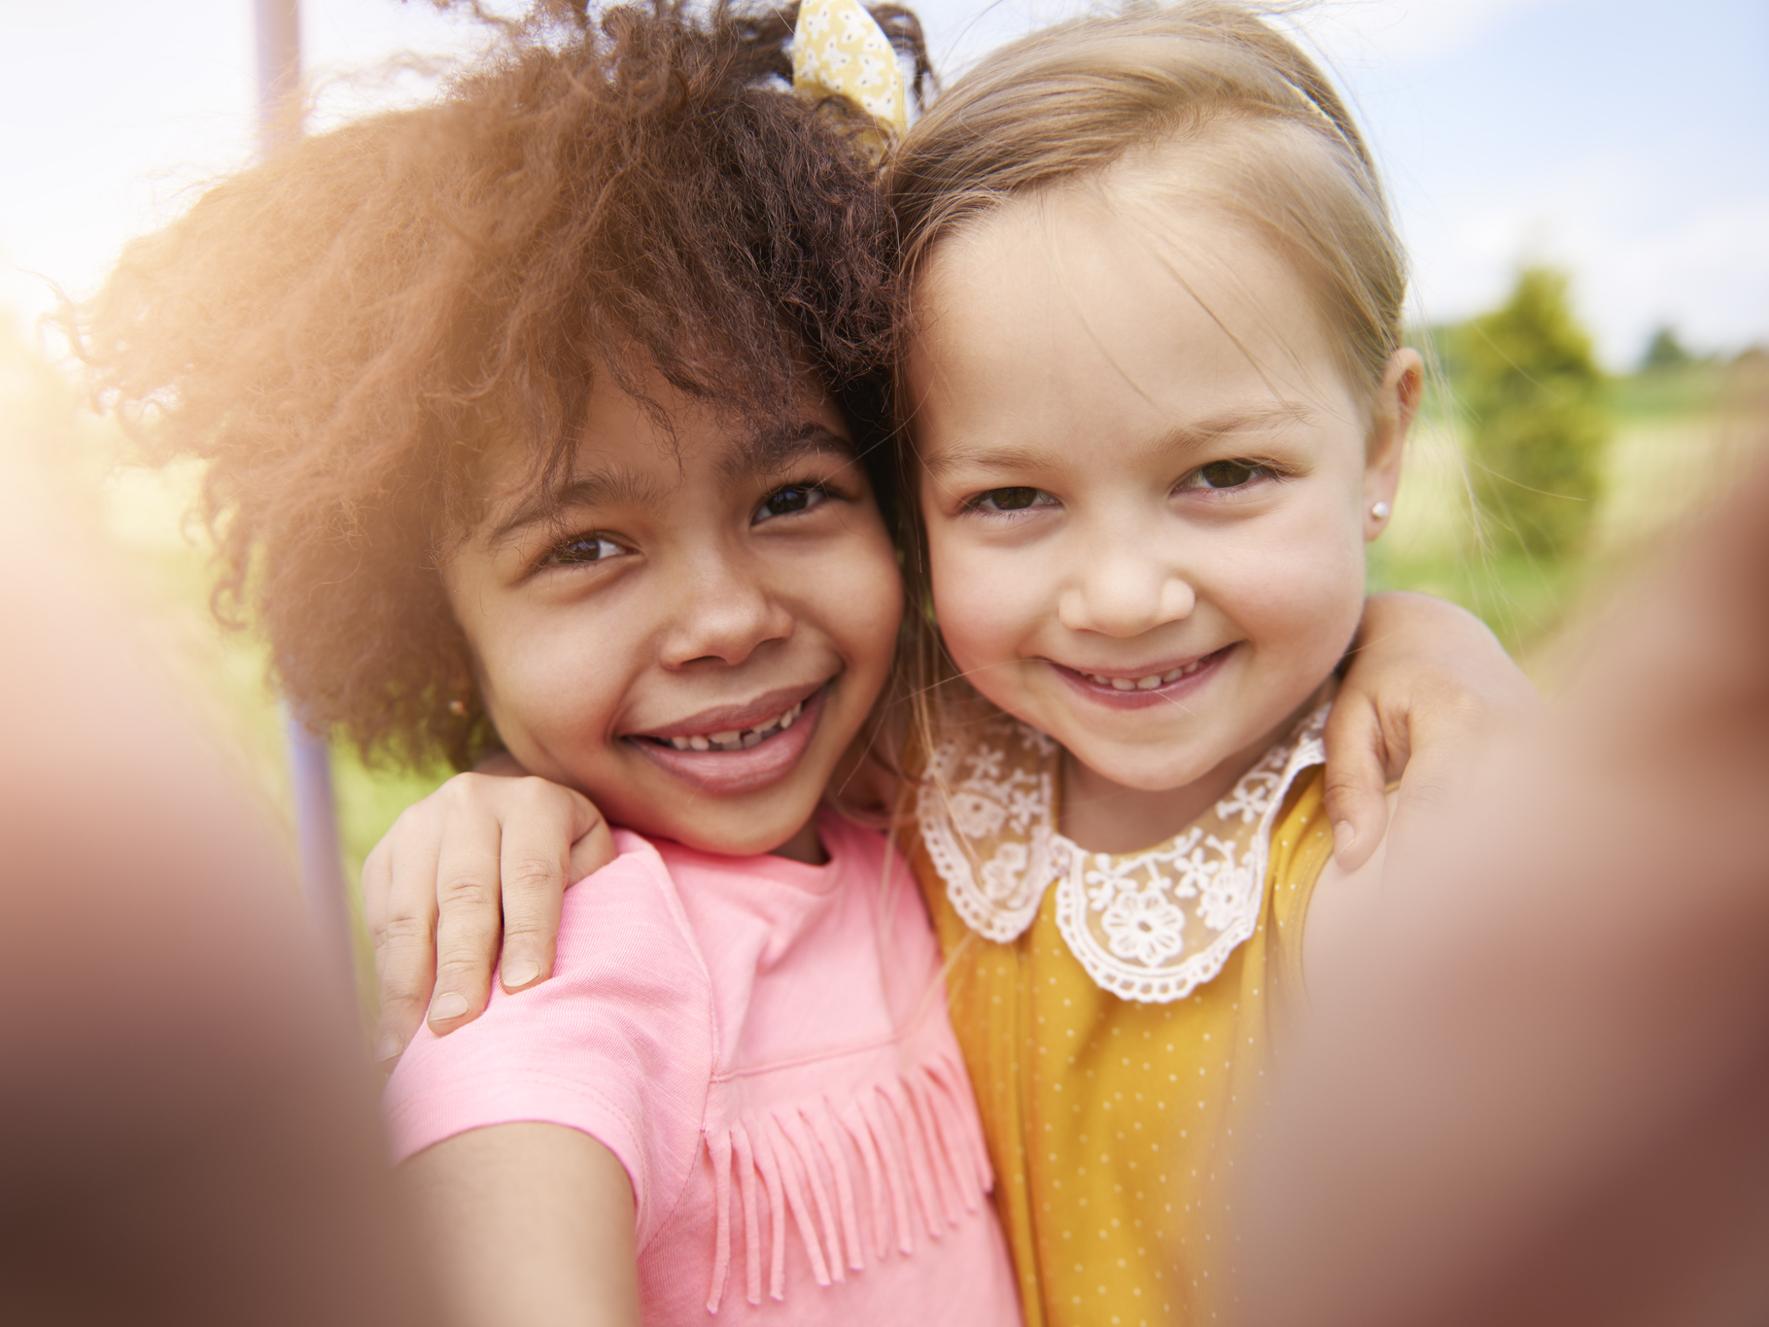

Slide 2
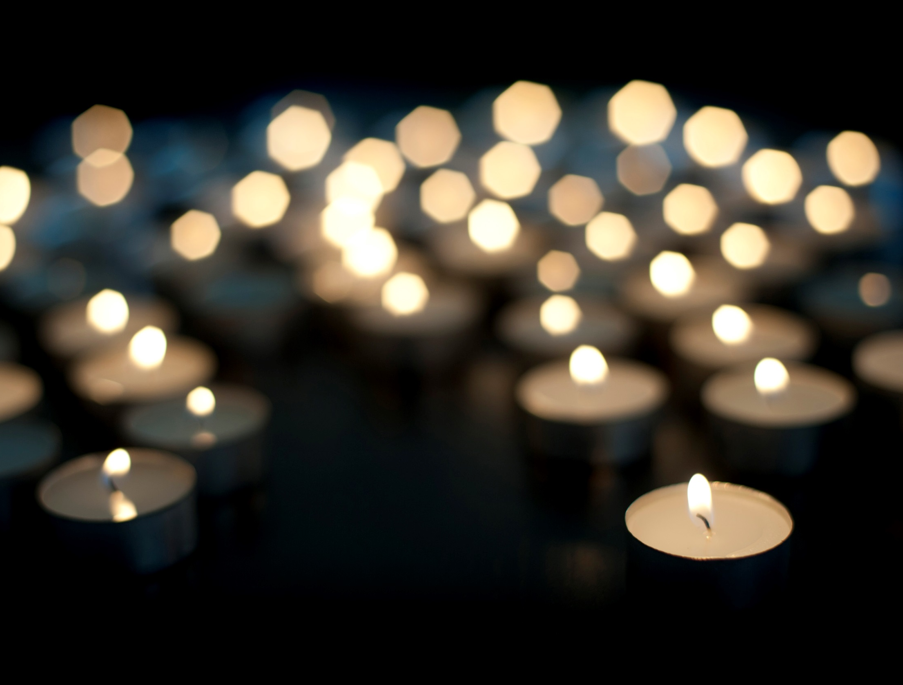

Slide 3
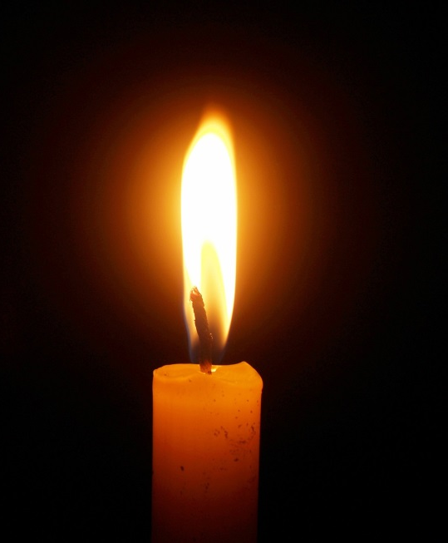
Matthew 5:14-16
“You are like light for the whole world. A city built on a hill cannot be hidden. No one lights a lamp and puts it under a bowl; instead he puts it on the lampstand, where it gives light for everyone in the house.
“In the same way your light must shine before people, so that they will see the good things you do and praise your Father in heaven.”
Notes:
Read through Matthew 5:14-16. Explain that by the end of this activity pupils should be able to explain what Jesus means in this passage.

Slide 4
Lesson 1 What are my talents?

Slide 5
Talent
What do you think of when you hear the word talent?
Do you think of . . .
Notes:
Ask pupils- What do you think of when you hear the word talent? Take suggestions.
Do you think of . . .

Slide 6
Notes:
The X Factor is based on showcasing which talent? You could play YouTube clip of an audition.

Slide 7
Notes:
Strictly Come Dancing is all about finding out if someone is talented at what? You could play YouTube clip of a dance.

Slide 8
Notes:
Britain’s Got Talent is based on showcasing which talent? Lots of different talents! You could play a YouTube clip of auditions.

Slide 9
Talents
List as many talents as you can in three minutes.
Notes:
On p. 1 of their activity books pupils write down a list of all of the talents they can think of. Set a three minute timer.

Slide 10
Talents Bingo
Circle any of the following talents on your list.
Speaking in front of people
Singing
Taking photos
Dancing
Languages
Explaining things to people
Sports
Computer games
Playing a musical instrument
Making people smile
Sciences
Spelling
Telling funny jokes
Acting
Maths
Cooking
Reading
Being a good friend
Art
Listening
Building things
Looking after other people
Being kind
Gardening
Notes:
Ask pupils to look at their list and circle any talents on the slide that match with their list. Ask pupils- are there any other talents they can think of?
The first half of the list are more obvious talents, and the second half are talents we may take for granted. Explain that talents are things that we are good at.

Slide 11
Your Talents
Write your name at the top of the sheet of paper.
Pass your sheet to the person next to you.
At the bottom of the sheet, write down one thing that person is talented at.
Fold the paper up so you cannot see what you have written.
Pass the paper on to someone else in the class. That person then looks at the name at the top of the sheet and writes down another talent of that person.
Repeat until six people have each written a talent.
Notes:
If pupils need help, use the list of talents on the previous page.

Slide 12
Your Talents
Return your sheet of paper to the talented person!
Read through the talents your classmates have listed. Would you have listed those talents?
Notes:
Ask pupils how the list makes them feel? Would they have listed those same talents? Explain that we all have talents that are unique and special to us.

Slide 13
Your Talents
Pick one of your talents. In pairs, take it in turns to interview one another about that talent.

Slide 14
Talents Interview
What is your talent?
How did you discover your talent?
How long have you had your talent for?
How often do you use it?
Are you proud of your talent?
Do you have a role model who shares your talent?
Could you use your talent to help others?
Notes:
You can ask pupils to talk through the questions or write down responses in their activity books.

Slide 15
Matthew 5:14-16
“You are like light for the whole world. A city built on a hill cannot be hidden. No one lights a lamp and puts it under a bowl; instead he puts it on the lampstand, where it gives light for everyone in the house.
“In the same way your light must shine before people, so that they will see the good things you do and praise your Father in heaven.
Notes:
Read through Matthew 5:14-16 again. Ask pupils- What do you think Jesus means when he says ‘you are light for the whole world’ and ‘your light must shine before people?’ Your light is your talent. Jesus is explaining that you should not hide your talents but share them with others to do good things- ‘your light must shine before people.’ So how can you follow Jesus’ teaching and shine your light?

Slide 16
Shine your Light Activity Sheet
This Lent we will think about our talents and how we can use our talents to make the world a better place.
Write your talents in the orange box on your worksheet.
Every day think-
How can I use my talents and shine my light to make someone’s day brighter?
Write/ draw one thing you will do/ have done today to make someone’s day brighter.
Write/ draw something every day during Lent.

Slide 17
Notes:
Worksheet side 1

Slide 18
Notes:
Worksheet side 2

Slide 19
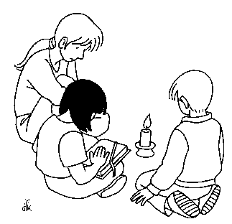
Prayer
Dear Lord,
Let us shine our light for you this Lent.
We all have special talents which you have given to us.
Guide us as we follow your teachings and use our talents to help others.
Let us shine our light for you this Lent.
Amen.
Notes:
Pray together

Slide 20
Lesson 2 How have other people used their talents?

Slide 21
Talents
Who do you think are the top three most talented people in the world?
Notes:
On p.2 of their activity sheet pupils write down the three people in the world who they think are most talented. Discuss as a class.
Most pupils will probably suggest famous singers/ dancers/ footballers etc.

Slide 22
Matthew 5:14-16
“You are like light for the whole world. A city built on a hill cannot be hidden. No one lights a lamp and puts it under a bowl; instead he puts it on the lampstand, where it gives light for everyone in the house.
“In the same way your light must shine before people, so that they will see the good things you do and praise your Father in heaven.”
Notes:
Do pupils remember this passage? Jesus is explaining that you should use your talents to make the world a better place. Look again at your top three. Have these people done good things to make the world a better place?

Slide 23
How have other people used their talents?
Read through the profiles and complete the table on p.3.
1. List that person’s talents.
2. How did they shine their light and use their talents to help others?
3. Look at your list of talents. Do you share any talents with that person?
Notes:
Explain that you are now going to investigate the lives of six people who were talented in different ways.

Slide 24
Class vote!
Who do you think is/was the most talented person?
Notes:
Ask pupils to raise their hands to vote for the person they think is most talented. Alternatively, you could ask them to move to the profile of the person they think is most talented. Ask them to explain why they have chosen that person.

Slide 25
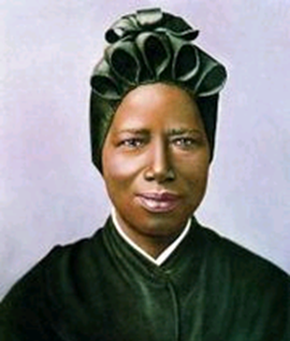

Slide 26
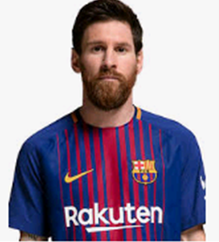

Slide 27
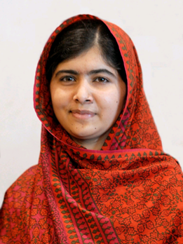

Slide 28
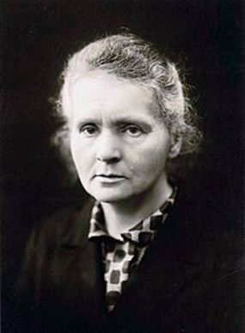

Slide 29
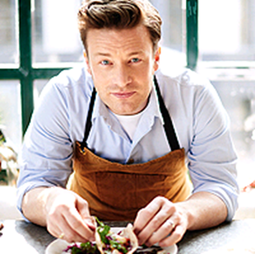

Slide 30
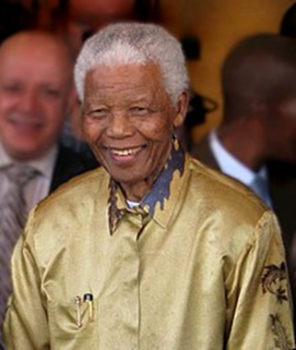

Slide 31
Prayer
Dear Lord,
Let us shine our light for you this Lent.
We all have special talents which you have given to us.
Guide us as we follow your teachings and use our talents to help others.
Let us shine our light for you this Lent.
Amen.
Notes:
Pray together

Slide 32
Lesson 3 How can I use my talents to make the world a brighter place?

Slide 33
1. Peter 4:10
Every person “must use for the good of others the special gift he has received from God.”
Notes:
Read 1. Peter 4:10. Ask pupils what this means? We must use our special gifts/ talents to help others.

Slide 34
Talents
Look back at your list of the top three most talented people in the world.
Do you still agree with your choices?
What makes someone talented?
What about people who are not famous?

Slide 35
How do people use their talents to make the world a brighter place?
Look at the following pictures and complete p.4 of your worksheet.
Draw a picture of that person’s job in the box.
Write down the talents needed to do their job.
Explain- how is this person shining their light?
Notes:
Click through the next four images, giving pupils time to complete the questions

Slide 36
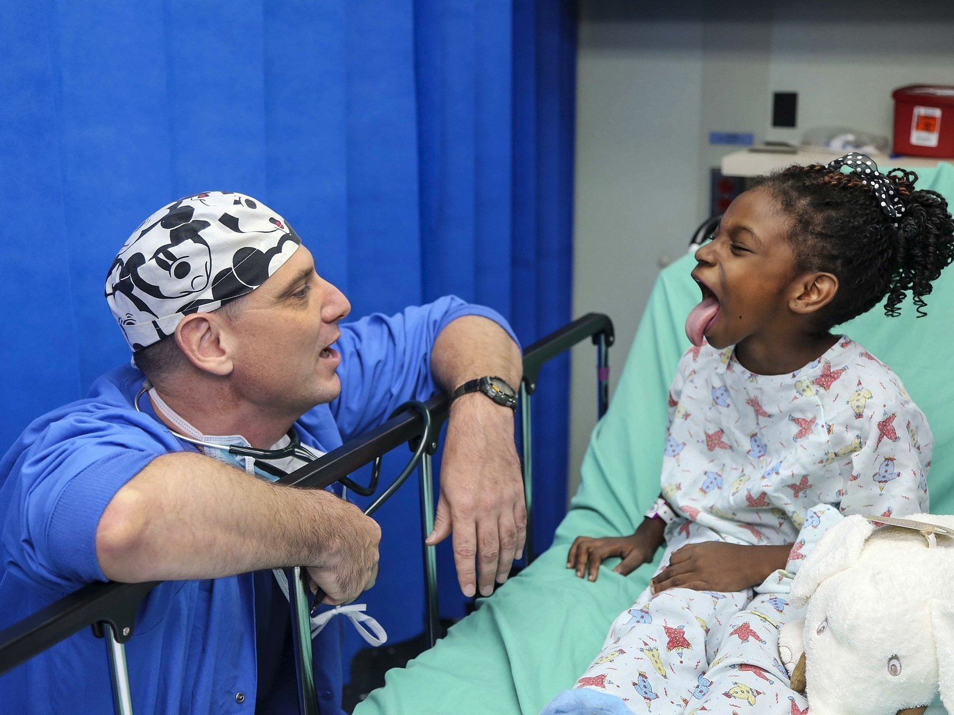
Notes:
Doctor
Caring, kind, listening, looking after people
Making people better

Slide 37
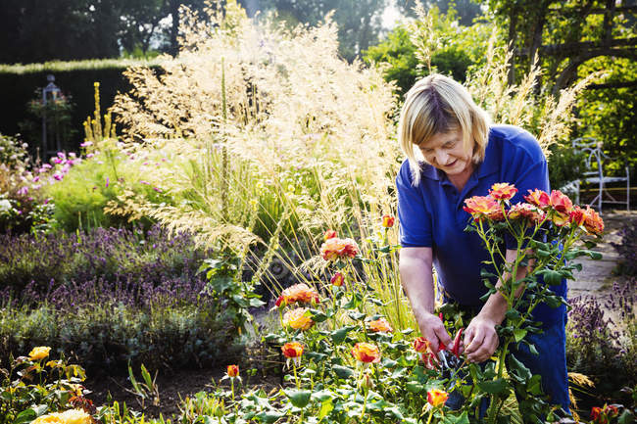
Notes:
Gardener
Looking after things, caring for nature
Making gardens nice so that others can enjoy it

Slide 38
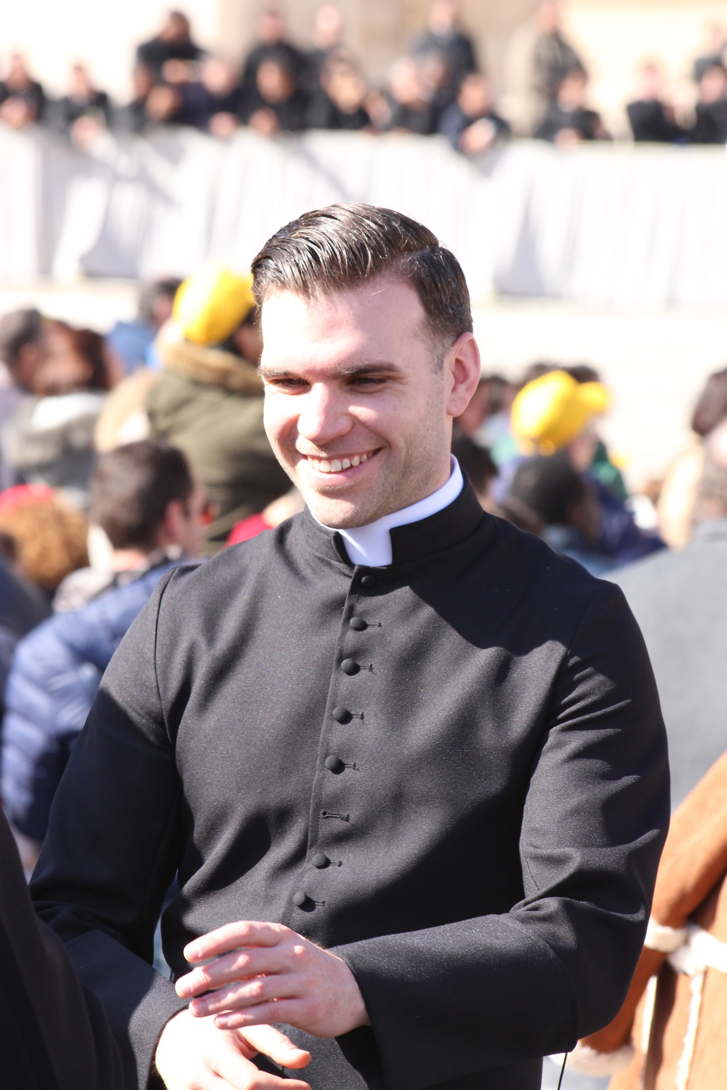
Notes:
Priest
Kind, caring, listening to people, public speaking
Guiding parishioners, helping them through problems, bringing communities together

Slide 39
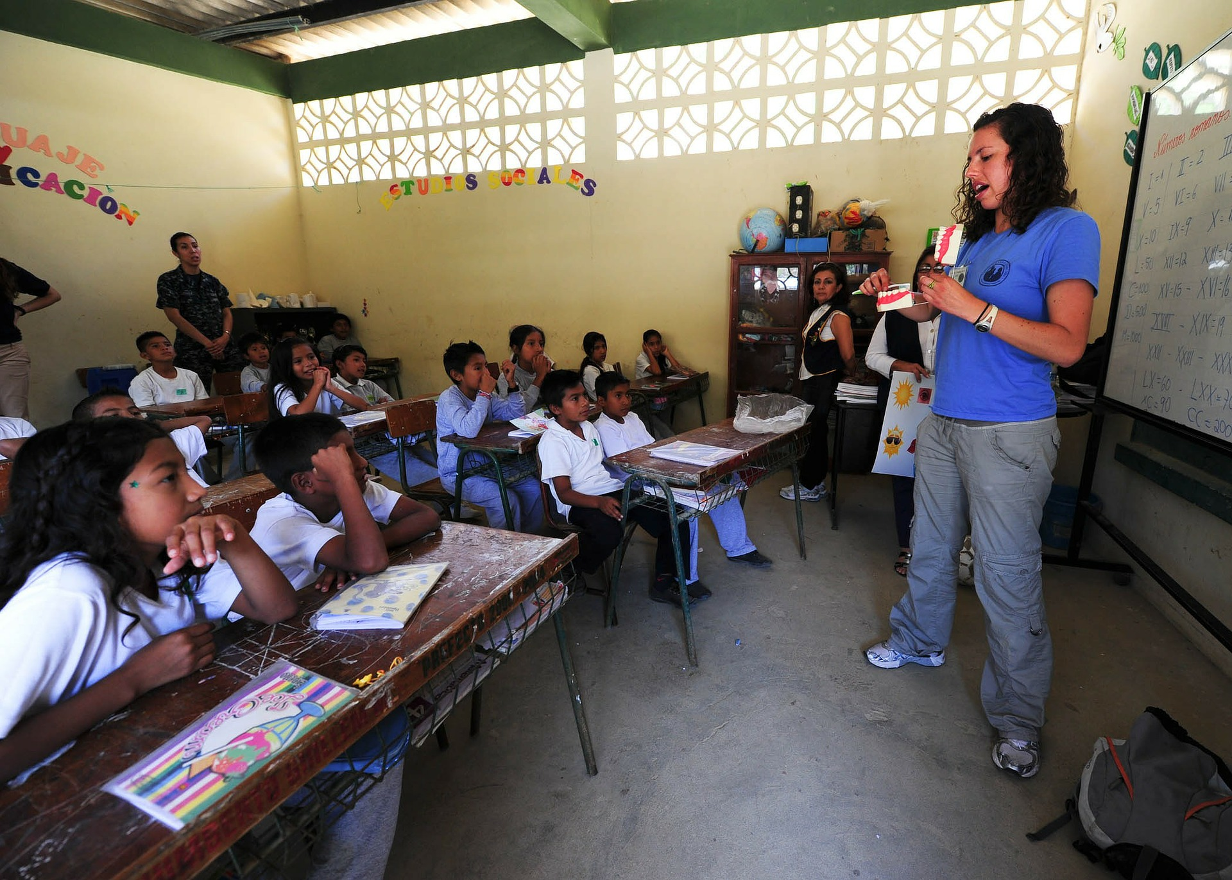
Notes:
Teacher
Public speaking, explaining things to others, being understanding, caring, kind
Educating children and young people to give them skills for later in life.

Slide 40
How can I use my talents to make the world a brighter place?
What job would you like to do in the future to shine your light?
Notes:
Pupils write down their answers on p. 4 of their activity book

Slide 41
How can I use my talents to make the world a brighter place?
How can we shine our light this Lent?
Think of three ways you can use your talents to raise money for the Catholic Children’s Society this Lent.
Notes:
Class discussion. E.g. if they are talented at singing or dancing they could organise a performance or talent show; if they are good at cooking they could bake and sell cakes; if they are good at explaining things they could tell someone they know about the work of the Catholic Children’s Society etc. Pupils then write down their ideas on p. 4 of their activity books.

Slide 42
Prayer
Dear Lord,
Let us shine our light for you this Lent.
We all have special talents which you have given to us.
Guide us as we follow your teachings and use our talents to help others.
Let us shine our light for you this Lent.
Amen.
Notes:
Pray together.

