Slide 1
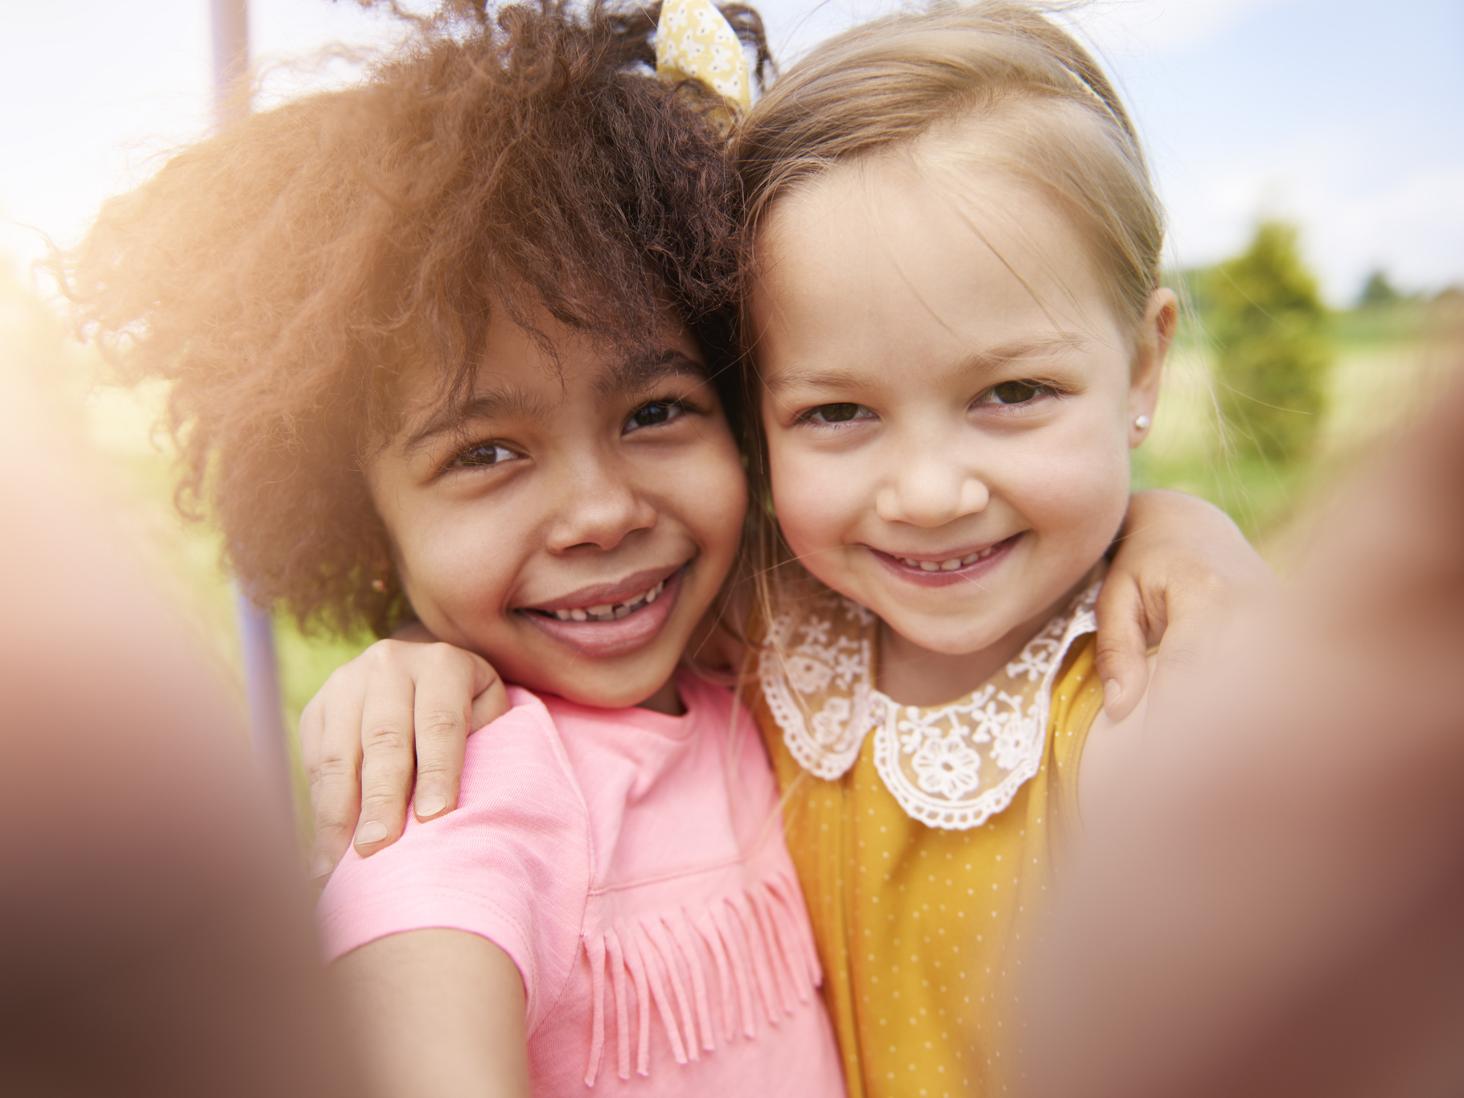

Slide 2
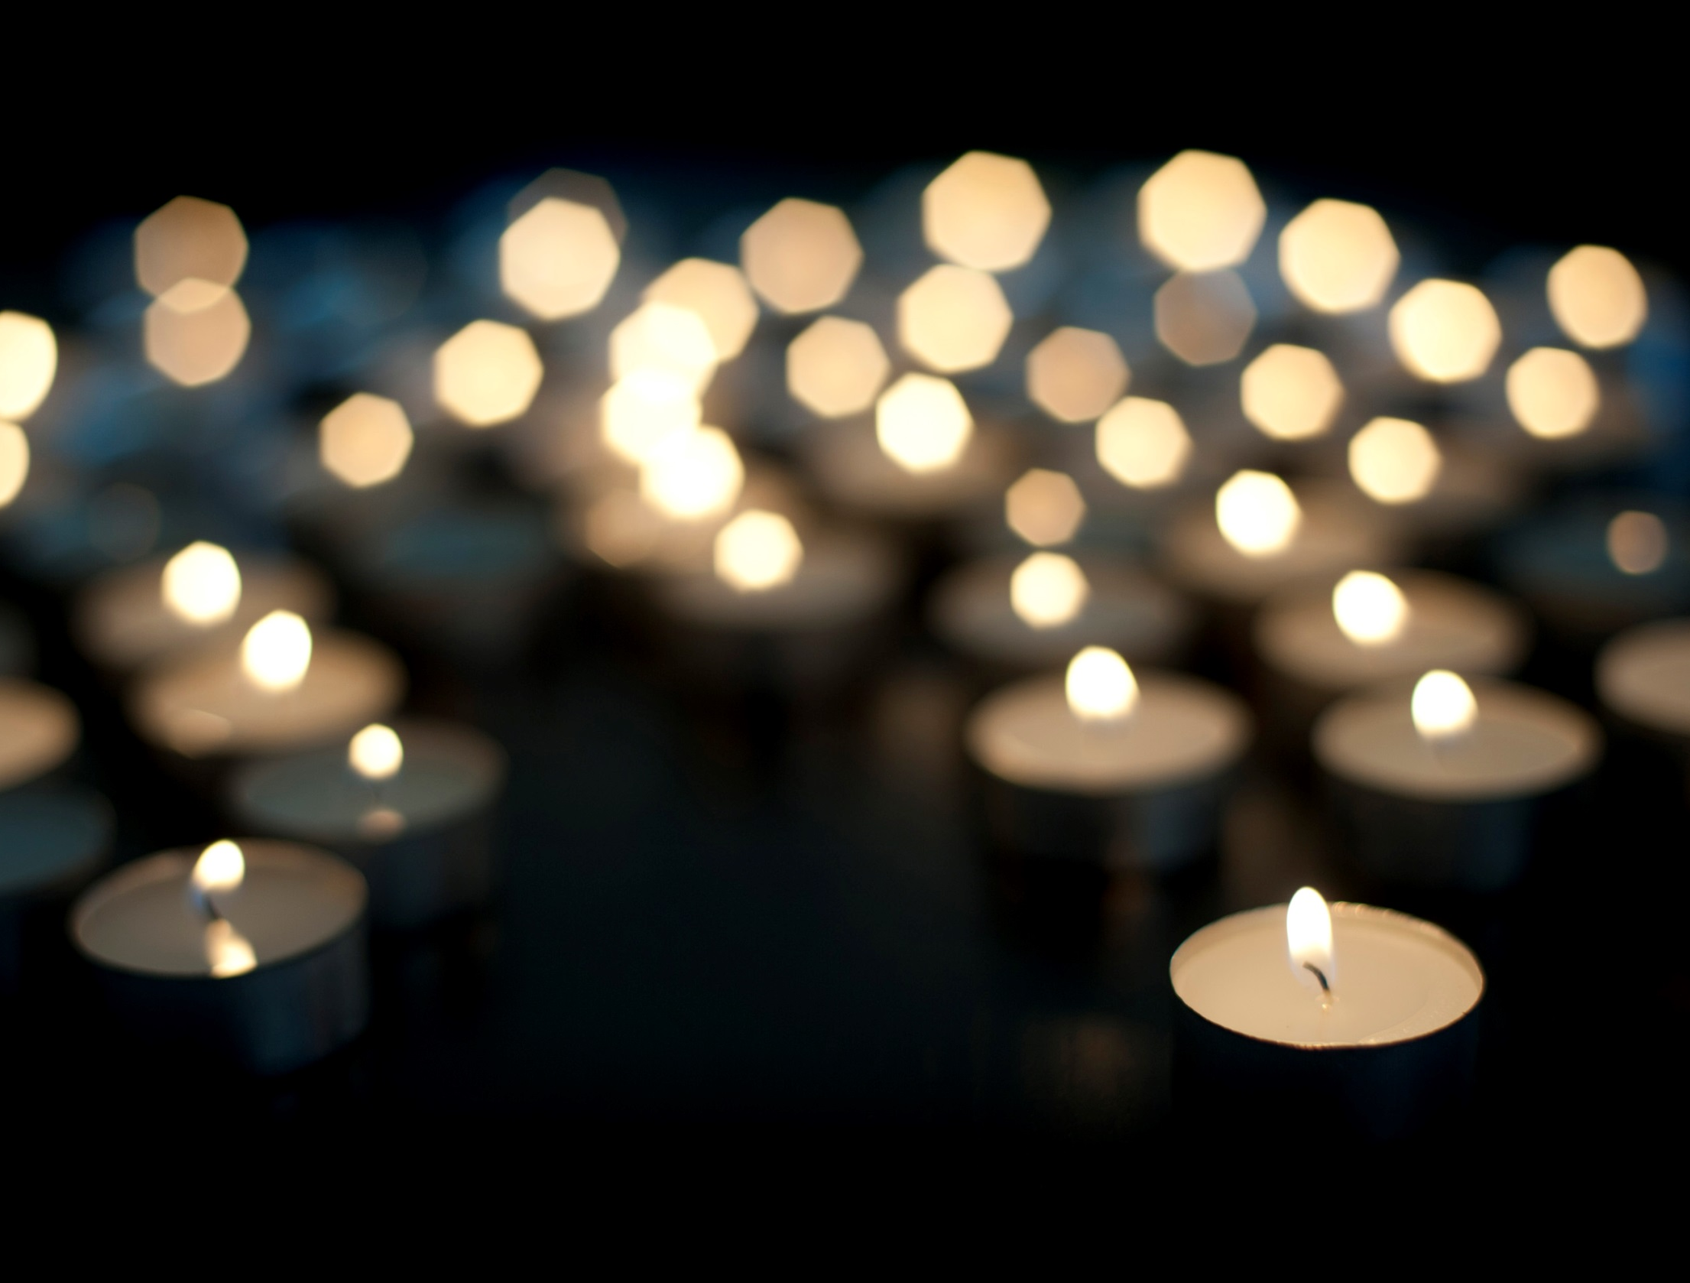

Slide 3
What are talents?
Notes:
Class discussion. Does anyone know what a talent is?

Slide 4
Notes:
People on the X Factor have which talent? You could play YouTube clip of an audition.

Slide 5
Notes:
People on Strictly Come Dancing have which talent? You could play YouTube clip of a dance.

Slide 6
Notes:
People on Britain’s Got Talent have which talent? Lots of different talents! You could play a YouTube clip of auditions.

Slide 7
Talents
Speaking in front of people
Singing
Taking photos
Dancing
Languages
Explaining things to people
Sports
Computer games
Playing a musical instrument
Making people smile
Sciences
Spelling
Telling funny jokes
Acting
Maths
Cooking
Reading
Being a good friend
Art
Listening
Building things
Looking after other people
Being kind
Gardening
Notes:
Explain that different people are talented (good at) different things. Discuss the different things people can be talented at. In pairs, pupils tells the person next to them 3 things that they are talented at.

Slide 8
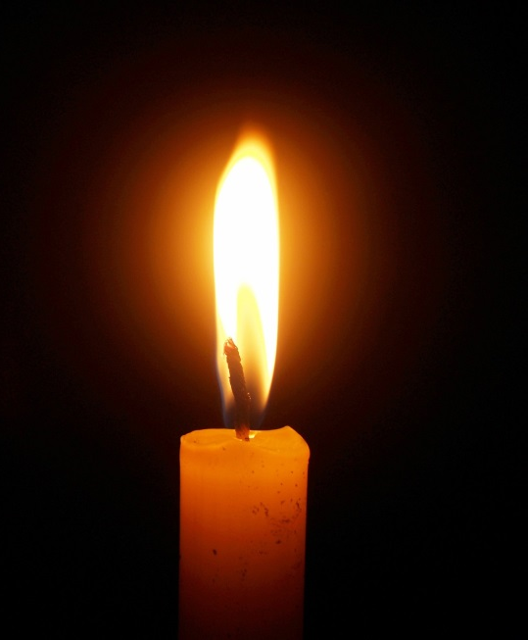
Sharing our talents
Jesus tells us that we should not keep our talents to ourselves.
We should share them with everyone to make the world a better place.
We are going to learn about someone who used their talents to make the world a better place.

Slide 9
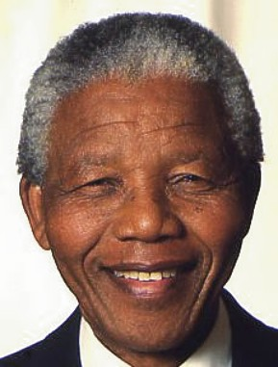
Nelson Mandela
Nelson Mandela was born in South Africa in 1918

Slide 10
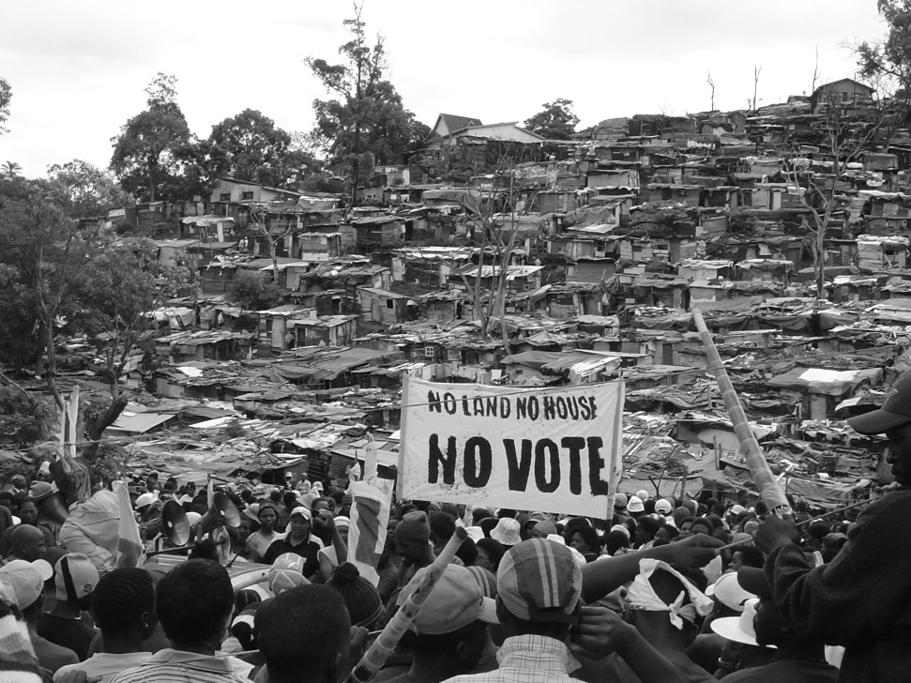
Nelson Mandela
Until 1992, the government in South Africa ran an apartheid. An apartheid is when black people have to live apart from white people.
Most black people had no jobs, were very poor and could not vote because of this.

Slide 11
Nelson Mandela
Nelson grew up in a village and went away to study law when he was a young man. He was very talented at speaking in public and explaining things to people.
He wanted to use his talents to help free black people from apartheid.

Slide 12
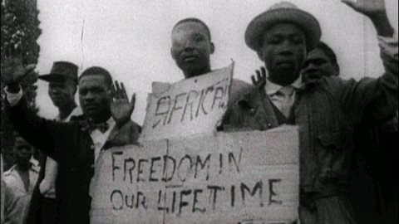
Nelson Mandela
In 1944 he joined the African National Congress (ANC).
People across South Africa joined together to protest against apartheid.

Slide 13
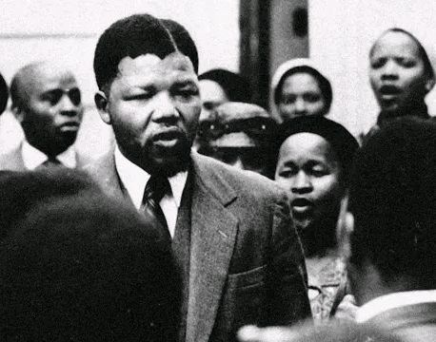
Nelson Mandela
In 1960 the government arrested many black people for taking part in these protests.
Nelson was arrested and spoke out about how unfairly black people were being treated in South Africa.
Nelson was sent to prison in 1963.

Slide 14
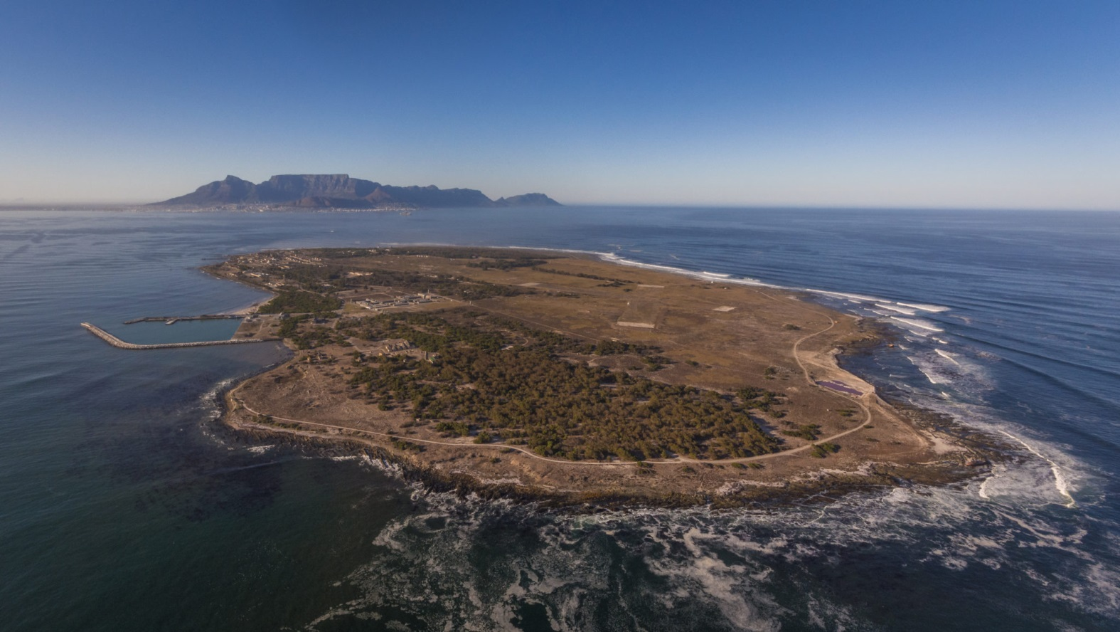
Nelson Mandela
Nelson Mandela spent 27 years in prison. He was imprisoned on Robben Island.

Slide 15
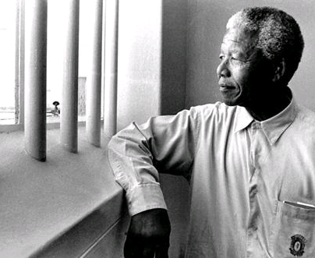
Nelson Mandela
Nelson was released in 1990. When people asked him if he was angry about being sent to prison for so long, Nelson said that he was not angry, he just wanted to look to the future and help make South Africa a fairer and better place.
Nelson also had a talent for being forgiving and kind.

Slide 16
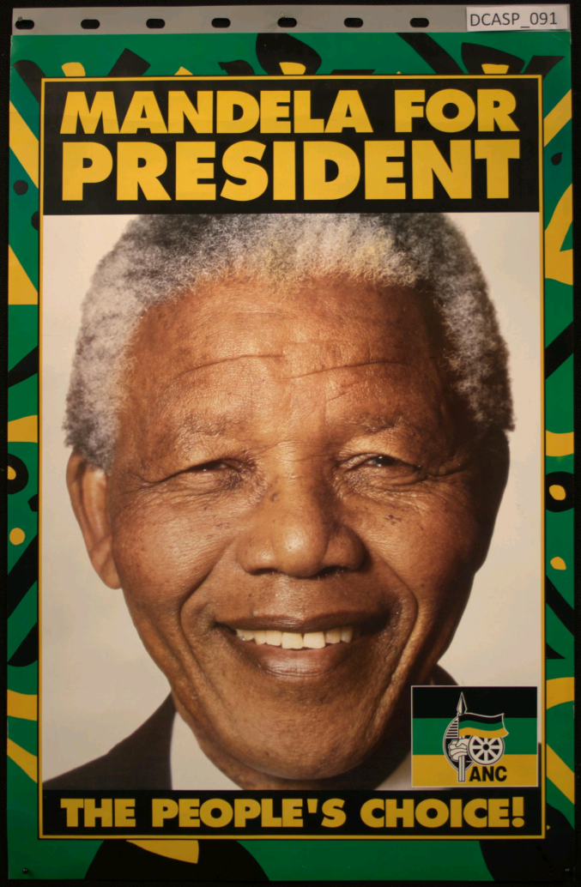
Nelson Mandela
Nelson used his talents of public speaking and bringing people together to end apartheid.
In 1993 he won the Nobel Peace Prize.
When apartheid ended black people were allowed to vote for the first time and Nelson became the new president of South Africa in 1994.

Slide 17
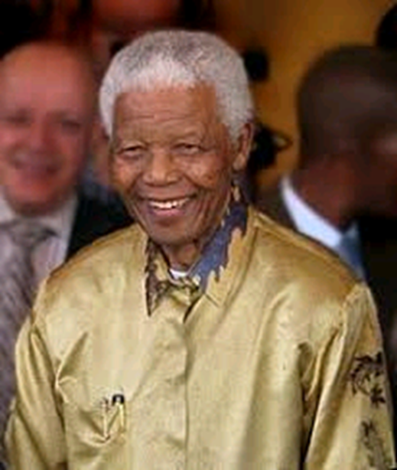
Nelson Mandela
He worked to bring peace to the country.
He retired in 1999 but continued to help people all around the world.
Mandela died in 2013 at the age of 95.

Slide 18
Nelson Mandela
What were Nelson’s talents?
How did he use his talents to make the world a better place?
What can we learn from Nelson Mandela?

Slide 19
Shine your Light Activity Sheet
This Lent we will think about our own talents and how we can use our talents help others.
Draw three of your talents in the orange box.
Every day think-
How can I use my talents and help someone today?
When you use your talents to help someone, you can colour in a box!
How many boxes can you colour in this Lent?

Slide 20
Notes:
Worksheet side 1

Slide 21
Notes:
Worksheet side 2

Slide 22
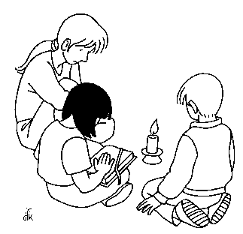
Prayer
Dear Lord,
Let us shine our light for you this Lent.
We all have special talents which you have given to us.
Guide us as we follow your teachings and use our talents to help others.
Let us shine our light for you this Lent.
Amen.
Notes:
Pray together

