Slide 1
Notes:
Display whilst children enter.

Slide 2
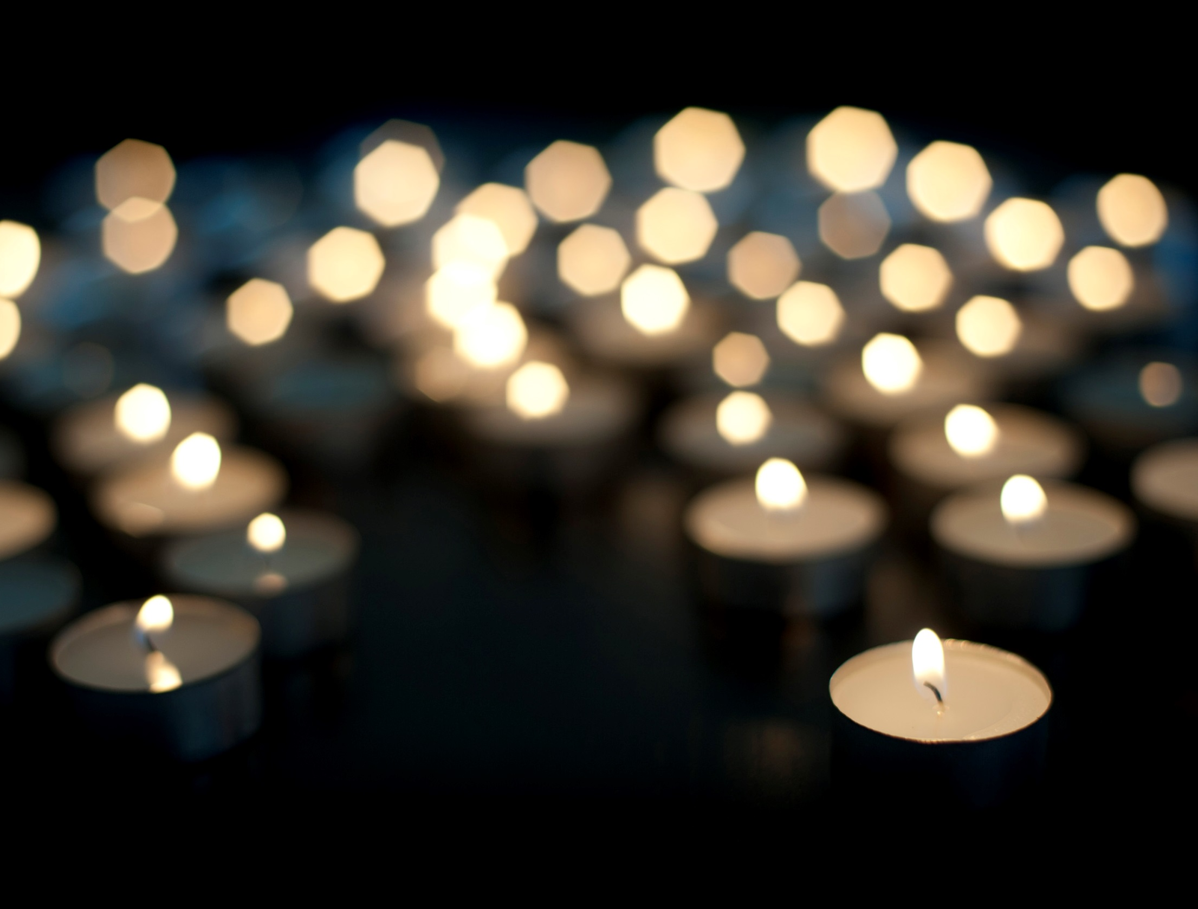

Slide 3
CCS Day
Reflect on your Lenten journey so far.
What have you done this Lent?
Have you used your talents to brighten
someone’s day this Lent?
We are only halfway through Lent.
What else can we do?
In silence, let us think about what we will do over the next three weeks.
Notes:
What have you done this Lent?- Group Discussion
Have you used your talents to brighten someone’s day this Lent?
We are only halfway through Lent-
what else can we do?
In silence, let us think about what we will do in the next three weeks. (encourage silent reflection for 1-2 minutes)

Slide 4
CCS Day
Today is CCS Day. Schools across London, Hertfordshire and the South East are joining together to give alms to the Catholic Children’s Society.
Can anyone tell me who the
Catholic Children's Society helps?
The Catholic Children's Society helps local children and young people in need.
Notes:
You can access children’s stories here:https://www.cathchild.org.uk/resources/childrens-stories-to-accompany-the-shine-your-light-worksheet/

Slide 5
CCS Day
What have we done this Lent to support the
Catholic Children's Society?
In silence, let us think about those children and young people we are helping this Lent.
Notes:
What have we done this Lent to support the Catholic Children's Society? Take ideas- fundraising activities, prayers
In silence, let us think about those children and young people we are helping this Lent. Encourage silent reflection for 1-2 minutes

Slide 6
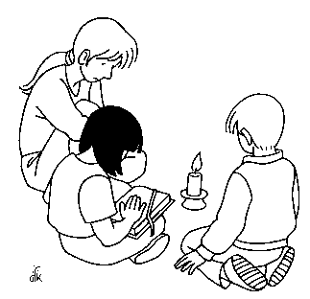
Prayer
Dear Lord,
Let us shine our light for you this Lent.
We all have special talents which you have given to us.
Guide us as we follow your teachings and use our talents to help children in need.
Let us shine our light for you this Lent.
Amen.

