Slide 1
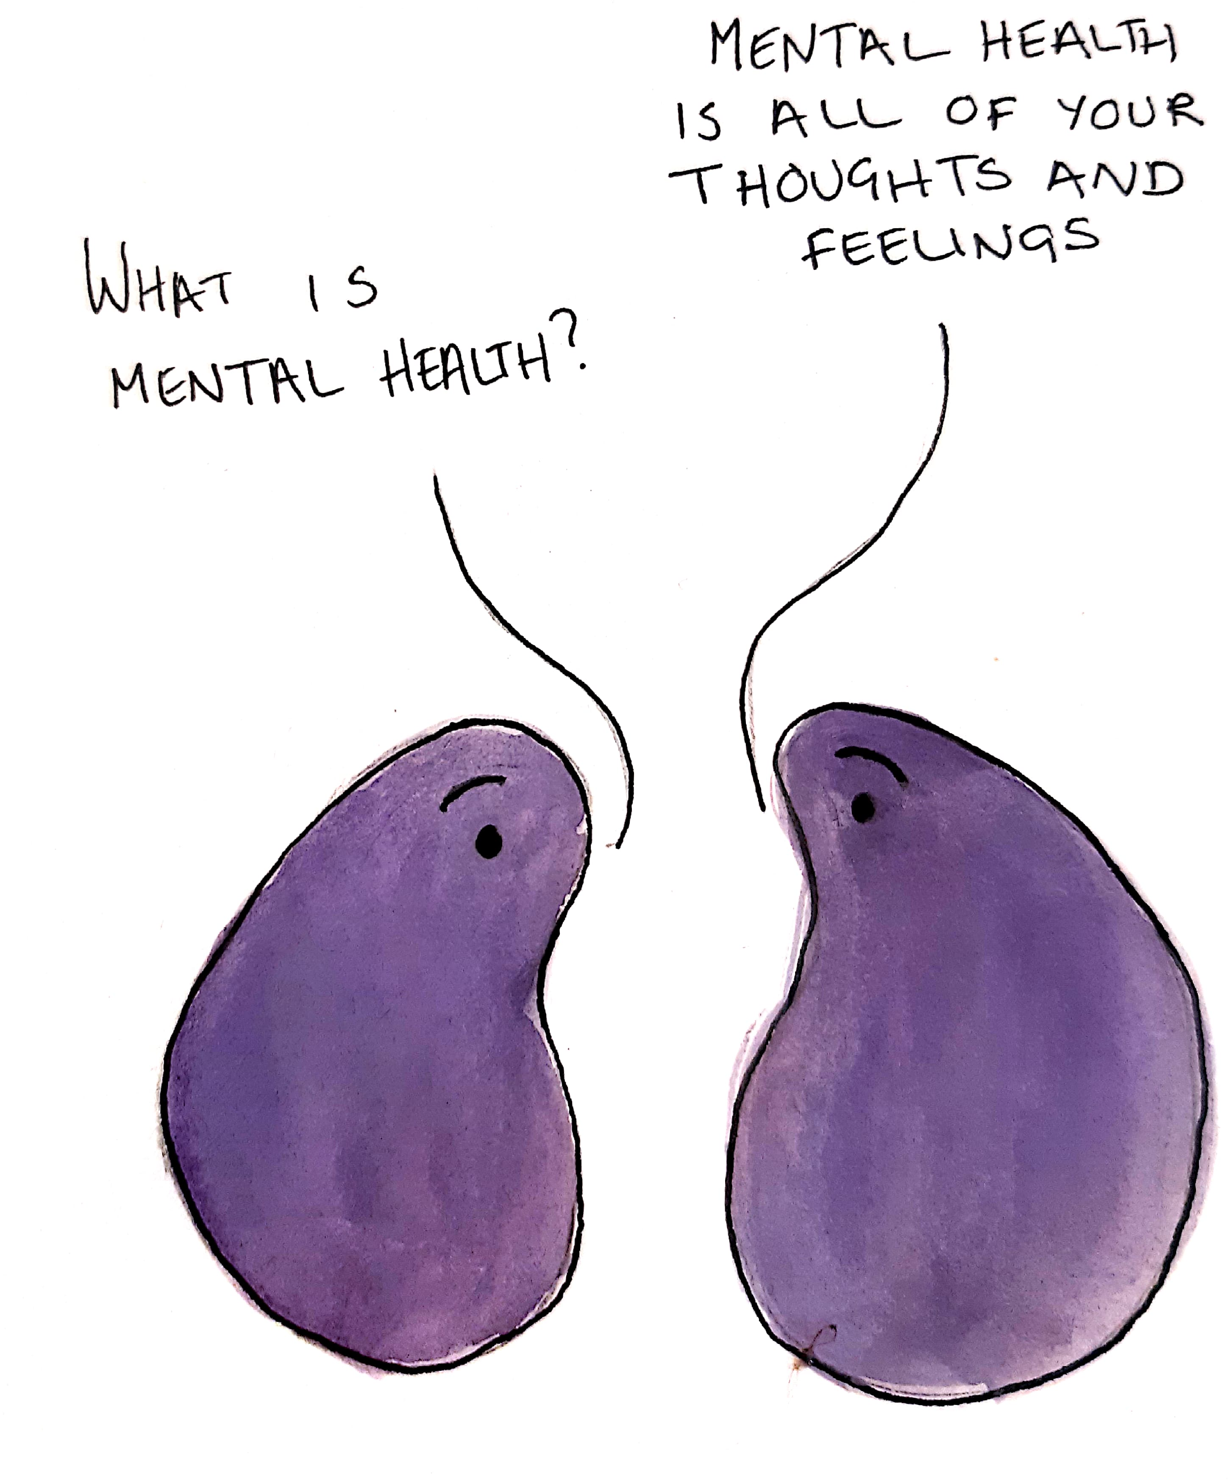
Children's Mental Health Week 2021
The importance of expressing our feelings and connecting with others to support good mental health.

Slide 2
Connecting with our feelings
We all feel a range of feelings throughout each day. It's important to acknowledge and express your feelings in a way that works for you.
It's important to express your feelings because our feelings communicate how we feel inside to the outside world and help us to get our needs met.
For example, if you are feeling lonely, it's important you acknowledge this feeling and find a way to express it to someone you trust so that you feel less alone. We can use art, music, writing and words to express how we feel.

Slide 3
Connecting with others
When we can acknowledge and express our feelings it helps us to connect with others. If I can connect with my own feelings of happiness and sadness, it helps me to imagine how others may be feeling too.
It is more important than ever to reach out to others for support and comfort during the pandemic. We all need more than one person to share our feelings with. If you need someone to talk to, see our signposts on the next slide.

Slide 4
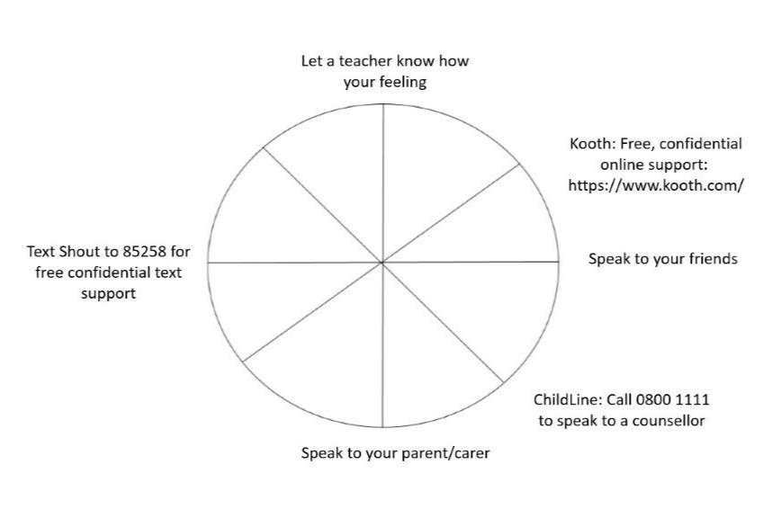
Signposts:

