Slide 1
LENT 2023
Ways to Connect
Connection Activities for Staff

Slide 2
Monday: Connecting with ourselves
Watch this video and consider the following as a staff team:
What are some ways that you build a sense of safety, consistency and trust in your classroom environment? And in your interactions with pupils?
Pick an idea shared by a colleague to try in class this week. Feed back to each other on how it went.
Link for video:
https://www.youtube.com/watch?v=roZvaHhXLlc

Slide 3
Monday: Connecting with ourselves
Knowing me, Knowing you!​
Spend time with the children/young people in your class getting to know more about them. Find out an interesting fact about them that you didn't know previously, that has nothing to do with their learning. ​
​
*This isn't a collective what's your favourite colour activity. It should happen in conversation.
The ‘2 x 10’ Strategy
Focus on students whose behaviour suggests they may have underlying mental health needs. For two minutes each day, 10 days in a row, have a conversation with the student about an interest they have.
Ideas from the Anna Freud Centre Classroom Wellbeing Toolkit:
https://www.annafreud.org/media/17009/classroom-wellbeing-toolkit.pdf

Slide 4
Monday: Connecting with ourselves
Pass out notecards or scrap paper, then ask each member of staff to write down something about themselves they think no one in the room knows. Be sure they put their name on the card.
Then, deposit all the cards in a bag. Mix them up, draw one, and read the fact aloud. Let the group try to reason out who they think matches the card. You can do all the cards at once or save the bag and draw a few at each staff meeting throughout the year.

Slide 5
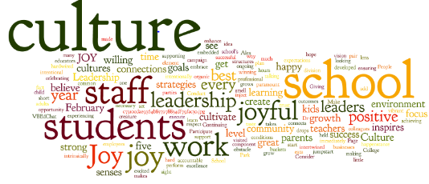
Monday: Connecting with ourselves
Give each member of staff five slips of paper and a pen. On each slip, have them write one word that they think describes the school culture.
Put people together in pairs to discuss their words. After five minutes, each pair narrows their ten cards down to the five they both like best.
Now, turn the pairs into groups of four, and repeat.
Continue until you’ve brought the entire group back together and collectively chosen the five words you all agree best represent your school.

