Slide 1
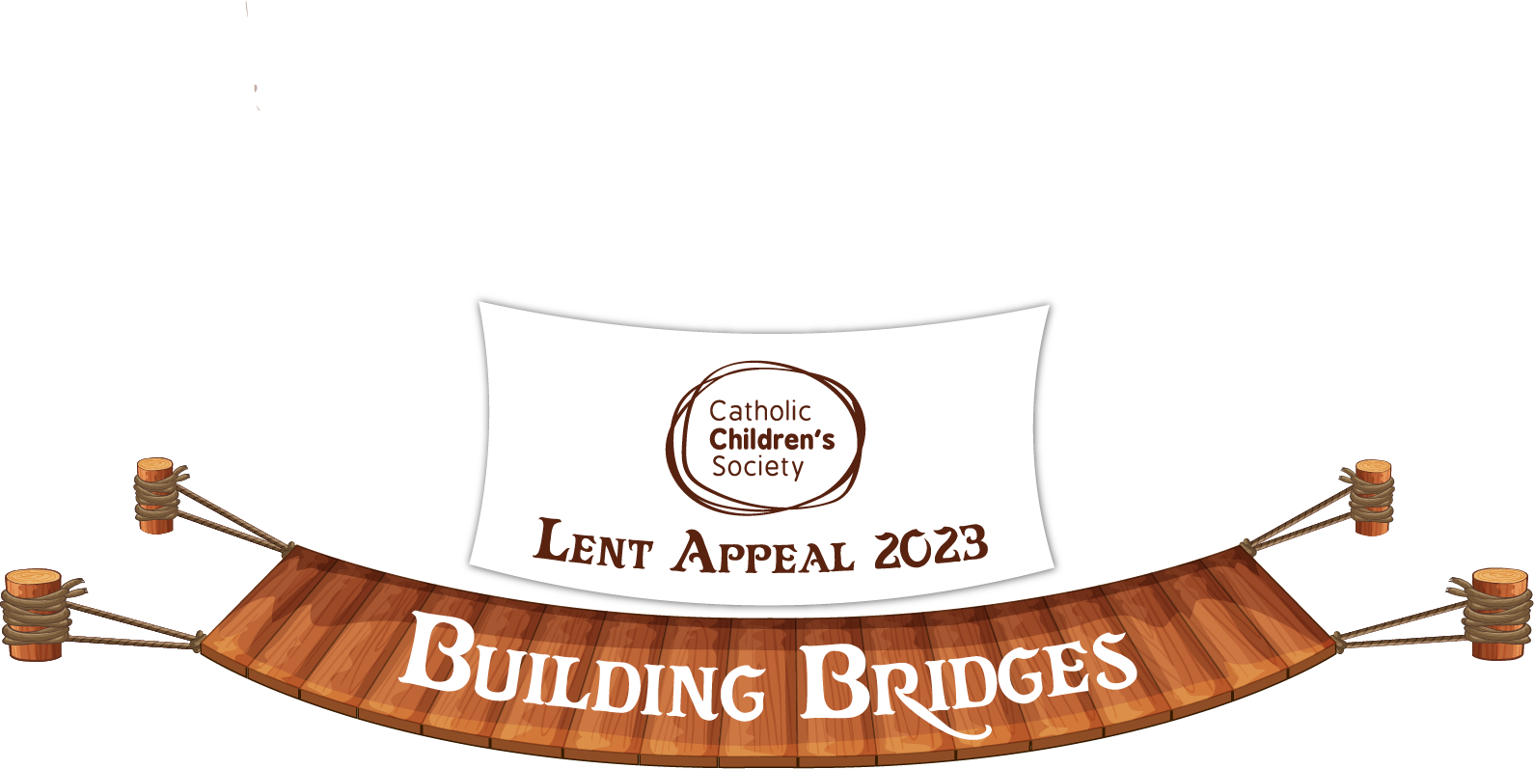
Connection Activities for Children

Slide 2
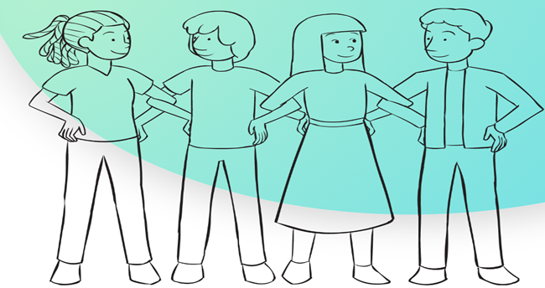
Making Connections
Step-by-Step Instructions
Gather your group in a large open space.
Ultimate objective is to create one large circle in which every person is physically linked with two others.
Ask one volunteer to stand with one hand on their hip, and then share one or more statements about themselves to the group.
When someone from the rest of the group hears a statement that they have in common with the first volunteer, they are invited to link elbows with them.
This second person then shares something about themselves to the larger group, to attract a new person to link elbows with them, and so on.
This process of sharing and linking continues one one by one.
To complete the circle, invite the last person to join the long chain of connections to share something about themselves to link with the very first volunteer.
Simple ice-breaker to connect group members to others.
2 - 5 min
The Connections Ice Breaker Game Helps Groups Make Alliances (playmeo.com)

Slide 3
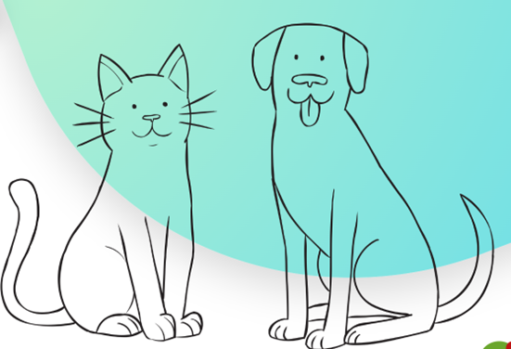
Are you more alike?
Step-by-Step Instructions
Download a set of ‘Are You More Like…’ questions https://www.playmeo.com/activities/ice-breakers-get-to-know-you-games/are-you-more-like/
Organise the cards so that you have one set of paired statements (a match) for every two people.
Randomly distribute one card to each person.
When ready, instruct each person to mingle with others until they find the person holding a card with their match, eg UP is matched with DOWN.
Once matched, invite partners to share their response to the question posed by the conjunction of their two cards, eg Are You More Like… a CAT or a DOG?
Encourage people to share as much as they feel comfortable.
When ready, randomly re-distribute the cards, and start again.
Continue this matching, sharing and re-distributing process for 10-15 mins.
Series of questions which help identify difference.
10 - 15 min
Are You More Like...? - Fabulous Get-To-Know-You Game for Groups (playmeo.com)

Slide 4
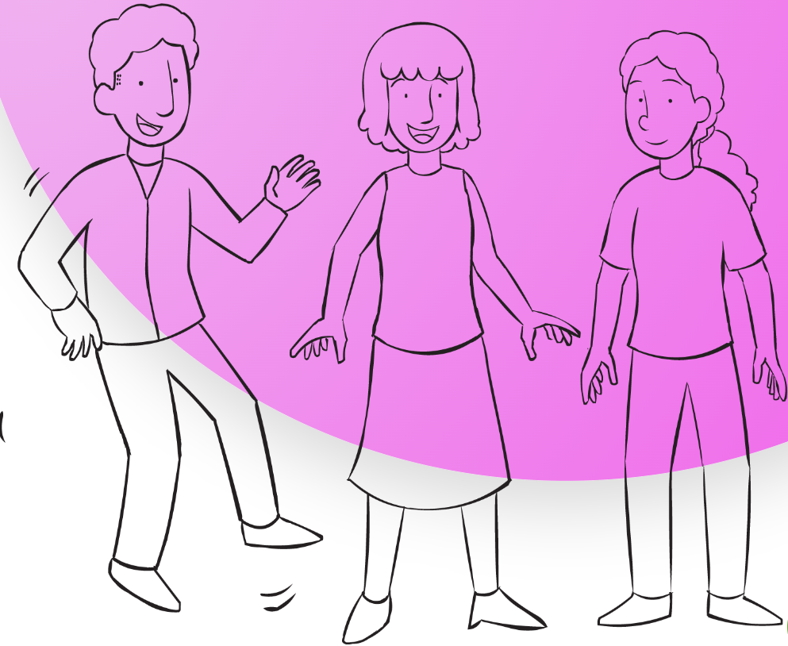
Super Smile
Step-by-Step Instructions
Form a circle, including yourself.
Challenge your group to record the fastest contagious smile ever!
By way of demonstration, start your stopwatch and pass a big smile as you make eye contact with someone across the circle from you.
Once this person smiles at you, start gently jumping up and down to indicate that the first smile has been sent.
The person who received your smile, now passes a smile to a new person in the circle.
The process of passing smiles continues until everyone in the circle has received a smile and passed a smile.
When everyone is jumping on the spot, stop the time.
Play for two or more rounds attempting to record the fastest contagious smile ever.
Active circle game to generate lots of smiles & laughter.
2 - 5 min
Promote Energy & Laughter With The Super Smile Group Game | playmeo

Slide 5
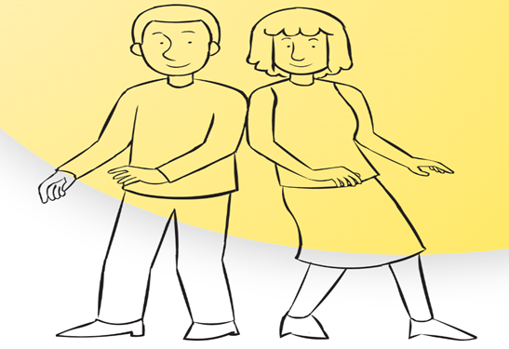
Lean Walk
Step-by-Step Instructions
Form into pairs, with someone of a similar height.
Standing side by side, ask each person to lean sideways towards their partner resting on one another’s shoulders.
Ask each person to shift their own feet away from their partner as far as they feel comfortable.
When ready, explain that each pair should aim to maintain this leaning stance as they walk together to an agreed point.
When ready, swap sides or swap partners.
Dynamic trust-building exercise for partners.
1 - 2 min
Lean Walk Trust-Building Exercise - Move Your Group & Build Trust (playmeo.com)

Slide 6
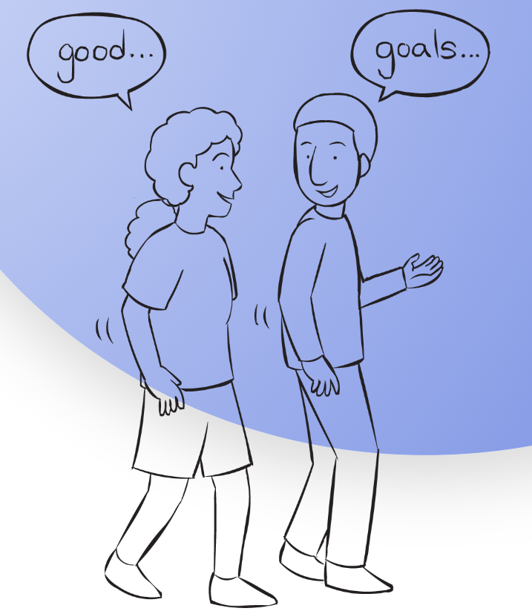
Three G Debrief
Step-by-Step Instructions
Form small groups of two to four people.
Announce that you would like each person to share their response to three G’s: – What’s Good in your life? – What’s Goofy about you? – What Goal(s) are you aiming to achieve?
Allow 2 to 5 minutes for conversation.
Simple, structured & versatile debriefing tool.
2 - 5 min
Three G Debrief - Simple, Structured & Open-Ended Reflection Activity (playmeo.com)

