Slide 1
Final Assembly

Slide 2
Lent Adventure

Slide 3
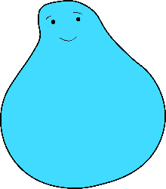
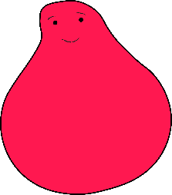
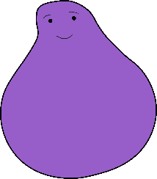
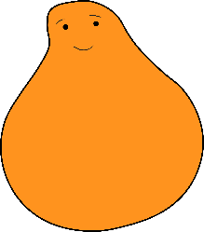
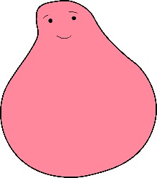
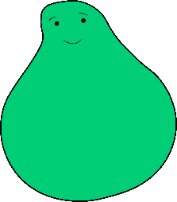
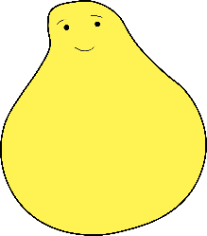
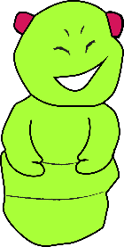
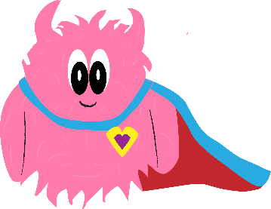
Lent Adventure
This Lent you helped a group of children on their adventure, using your special superpowers to connect to each other.
And you even helped the monsters, so they didn’t feel so scary anymore.

Slide 4
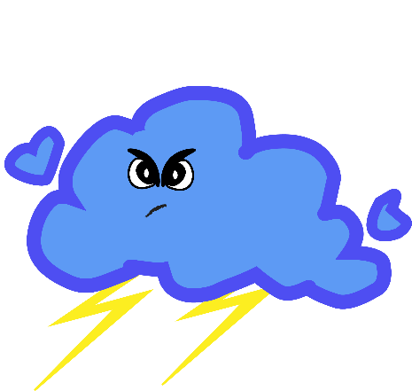
EYFS & Year 1
How did you use kindness?
What did you do to help the raincloud monster?

Slide 5
Year 2
How did you use patience?
What did you do to help the raincloud monster?

Slide 6
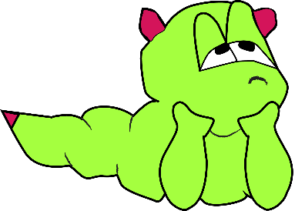
Year 3
How did you use curiosity?
What did you do to help the boredom monster?

Slide 7
Year 4
How did you use fun?
What did you do to help the boredom monster?

Slide 8
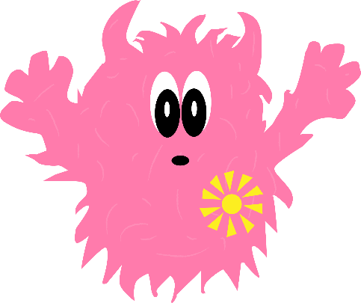
Year 5
How did you use courage?
What did you do to help the darkness monster?

Slide 9
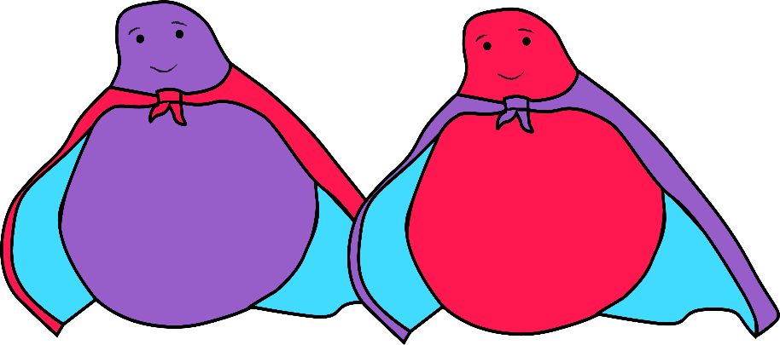
Year 6
How did you use teamwork?
What did you do to help
the darkness monster?

Slide 10
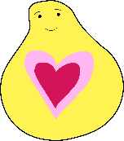
Well done!
1. How did your special powers help you to connect with others?
2. How did connecting with others help you?
3. What did you find tricky about connecting with others?
Well done! Thank you for your help on this Lent Adventure!

Slide 11
