Slide 1
Opening Assembly

Slide 2
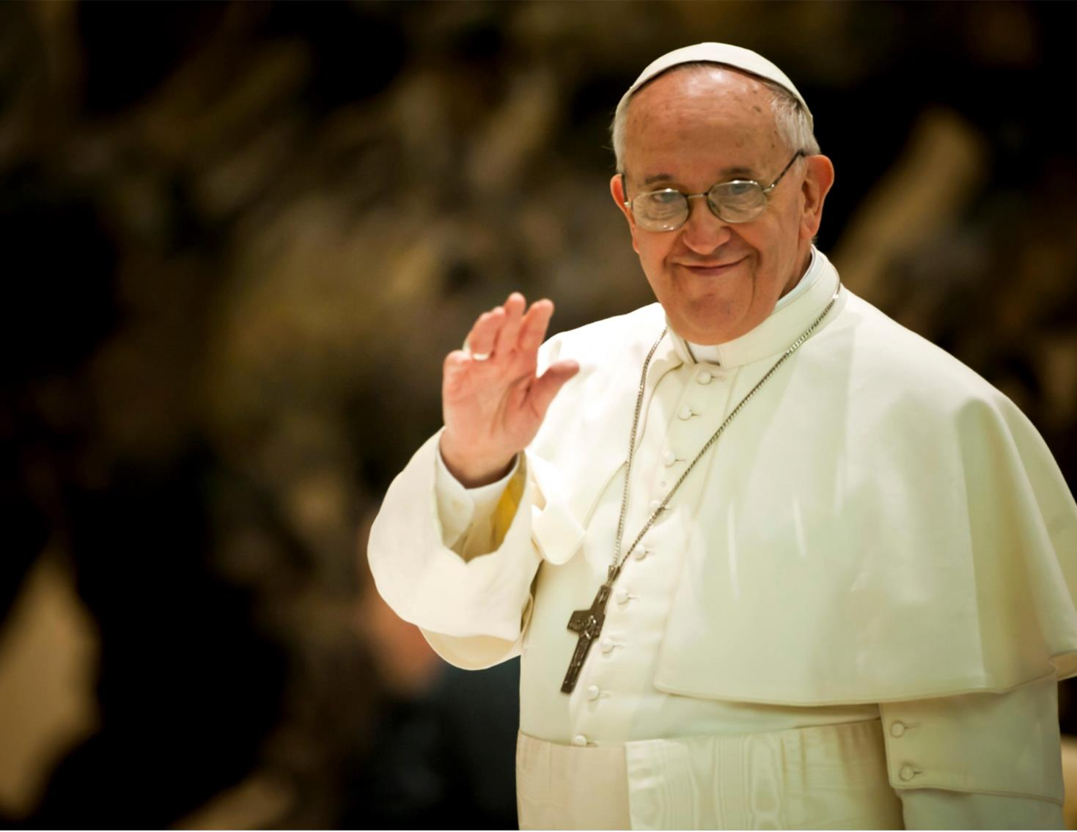
This year’s Lent Appeal is inspired by Pope Francis’s call:
“Build bridges, not walls . . . talk to one another, listen to each other, walk together”

Slide 3
Building Bridges
“Build bridges, not walls.” What do you think Pope Francis means?
How can we “Build bridges, not walls”?
Who can we “Build bridges” with?

Slide 4
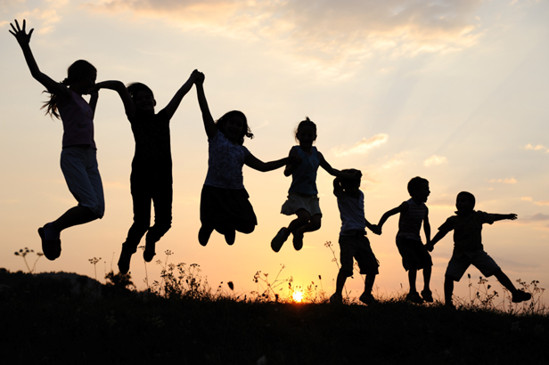
Our Connections
Pope Francis asks us to build bridges and form meaningful connections with others.
Forming positive, healthy and meaningful connections with other people is very important for our mental health and emotional wellbeing.

Slide 5
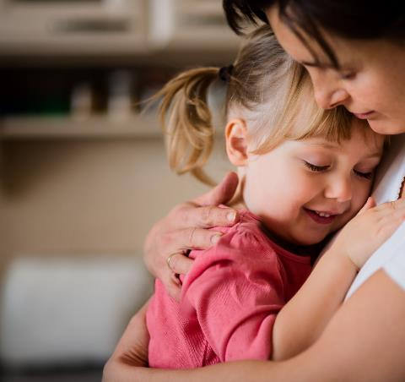
Our Connections
This Lent, we will also be thinking about how we can connect with children and families who need our help.
Our school will be raising money for the Catholic Children’s Society (CCS). CCS is a local charity that helps vulnerable children and families.
During Lent we will learn more about the work of CCS and the children they help.

Slide 6
Our Connections
The Catholic Children’s Society (CCS) is asking you to go on a Lent adventure and connect with others . . .

Slide 7
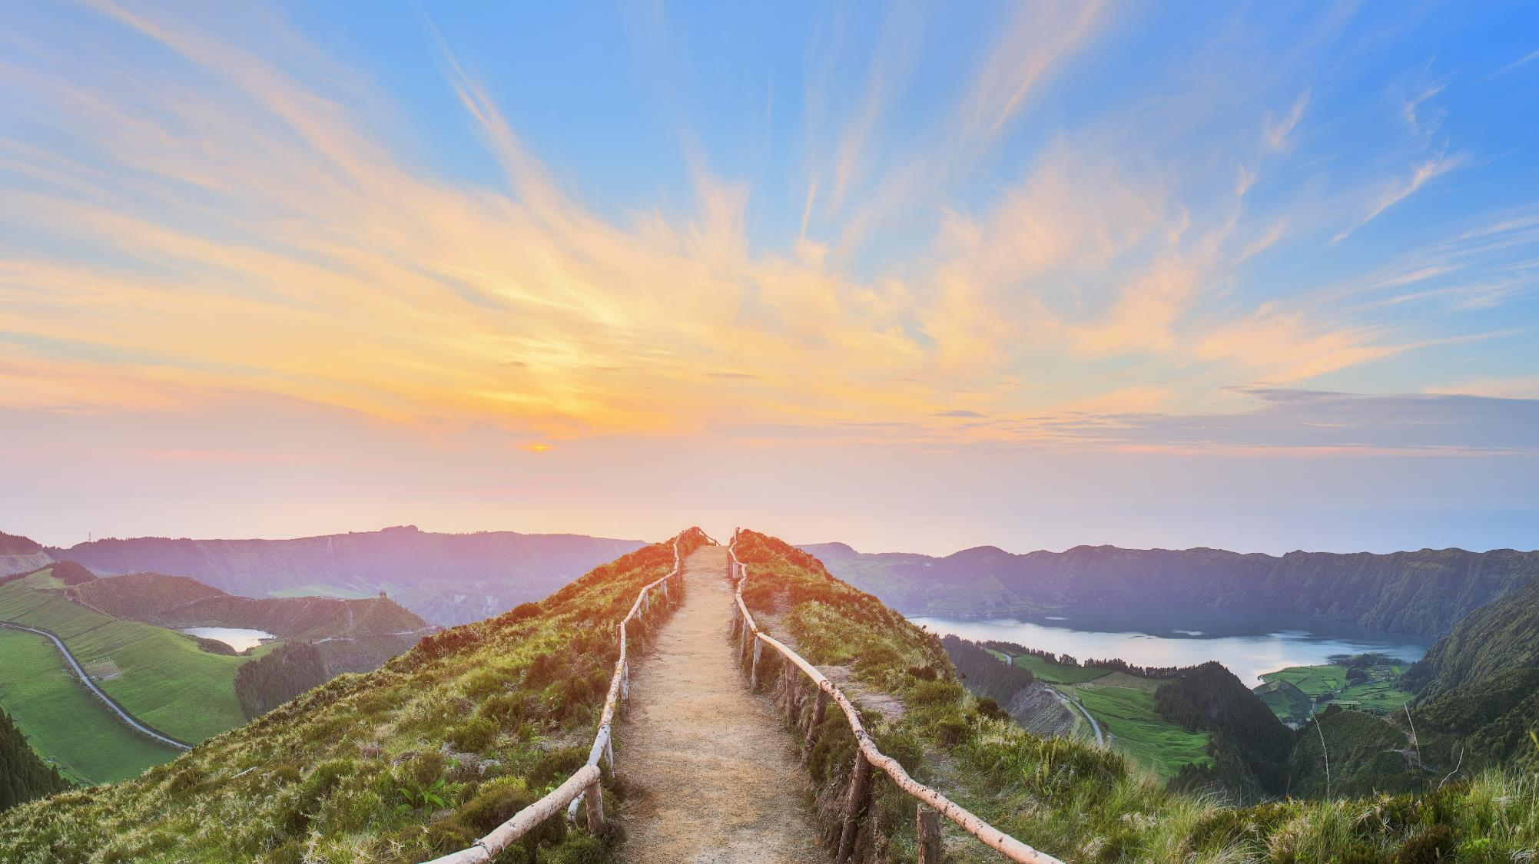
Lent Adventure

Slide 8
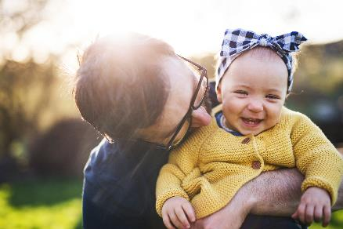
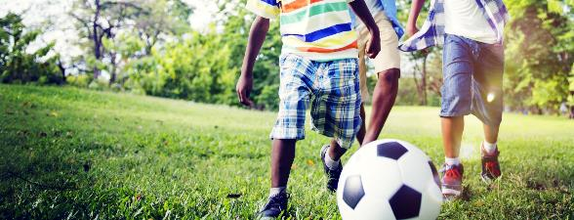
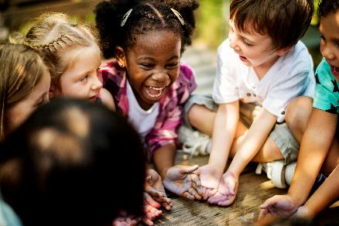
Our Connections
Your school is about to take part in an incredible adventure. On this adventure we will need to connect with other people.
1. Who do you connect with during your week?
2. Who do you connect with during special times in the year?
3. Who do you connect with during your school day?

Slide 9
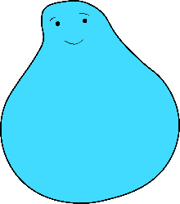
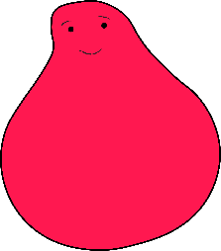
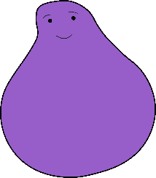
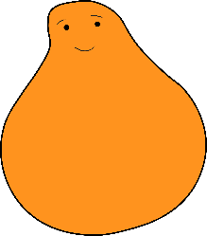
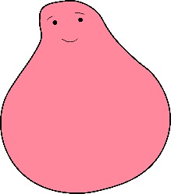
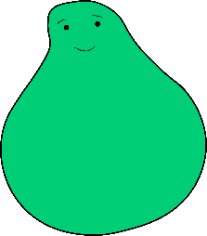
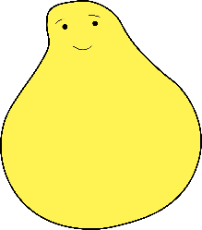
Lent Adventure
We need your help.
A group of children have set off on an exciting adventure…

Slide 10
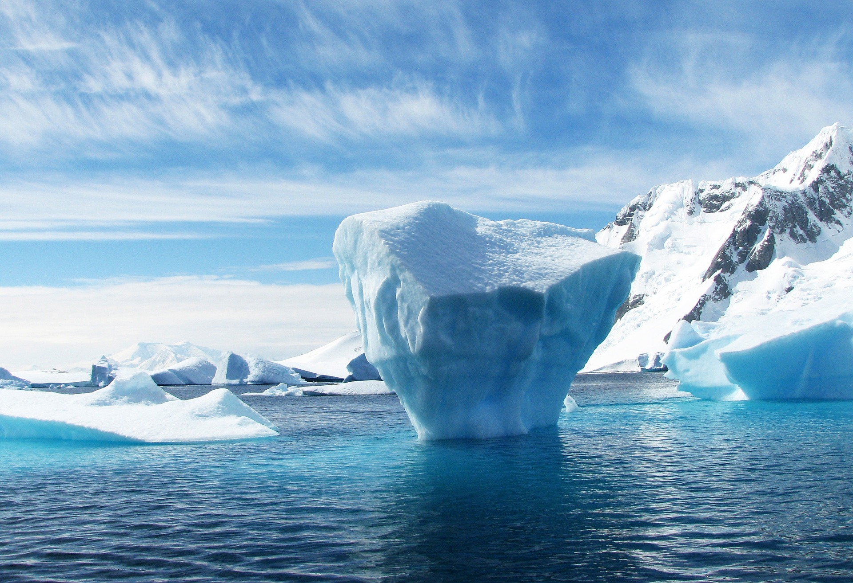
They hopped from freezing icebergs into the deep, dark ocean . . .

Slide 11
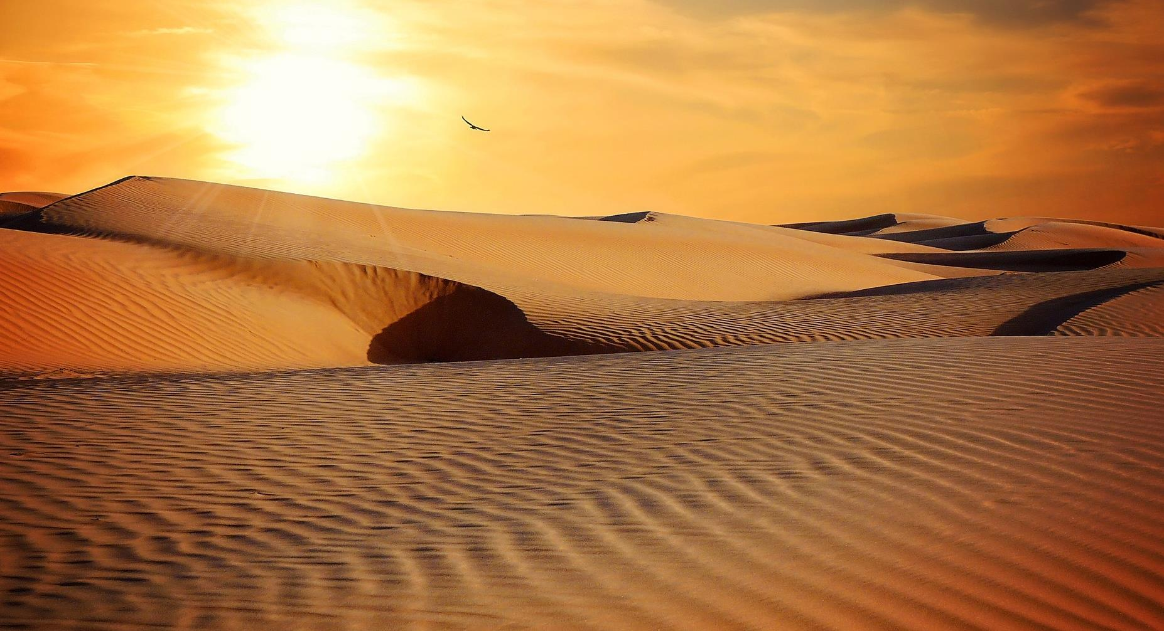
They trekked through the vast, sandy deserts . . .

Slide 12
. . . and even glided past magnificent sunsets in a hot air balloon.

Slide 13
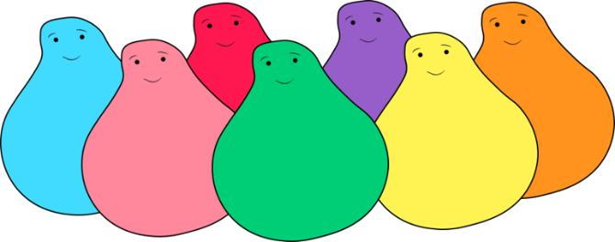
Lent Adventure
Now they want to come home but there is one last bridge to cross.

Slide 14
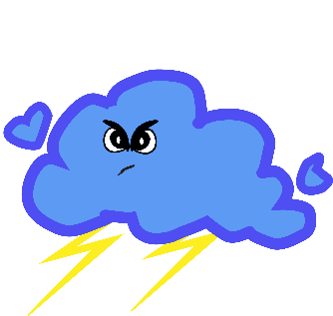
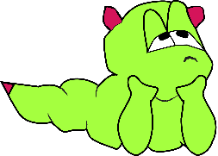
Monsters
Oh no! There are some sneaky monsters on the bridge and they want to stop the children coming home!

Slide 15
What do you need to do?
These monsters creep up on all of us in our lives but we don't always see them coming. They even sneak up on your teachers and head teacher! The only way to get past these monsters is for to use your special powers . . .

Slide 16
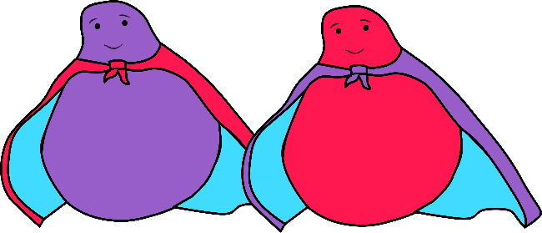
What do you need to do?
We all have special powers and our powers are the best way to deal with these sneaky monsters. The best thing about these special powers is you can use them to help others too. Each year group is going to use a different superpower.
PATIENCE
FUN
TEAMWORK
KINDNESS
CURIOSITY
COURAGE
Which superpower will your year group need to befriend the monsters and help the children get home? Your teacher will tell you when you start the adventure.
Good luck!

