Slide 1
Connection Activities for Children (SEN Version)

Slide 2
Guidance Notes for Staff
The following exercises include different suggestions which can be adapted according to learners’ needs.
Please note that ‘connection’ does not have to mean close proximity: in any of these exercises children may choose to observe and enjoy the activities without actively taking part and it is important to respect that.
They may still feel connected even if it seems they are not joining in. In fact, someone who does not want to take part may enjoy another role, like giving instructions.

Slide 3
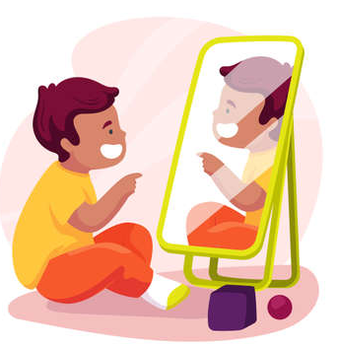
Mirror, Mirror
Step-by-Step Instructions
Put the children into pairs (you can pair children who need additional support with an adult). Designate one child in the pair as the “leader” and ask them to face each other.
The leader chooses a body posture or gesture and the other child mimics it, e.g. the leader may put one hand on their head and one hand on their belly. Every time the teacher claps/plays a sound on a musical instrument, the leader changes their position.
The leader and responder change roles.
HOW TO CHANGE IT UP:
You could do it as a whole class, with one child (the leader) in front of the class or a small group.
You could try with the leader moving throughout but as if in slow motion.
Challenge the children to think outside the box and attempt to hold different body positions while standing on one leg or sitting on the floor.

Slide 4
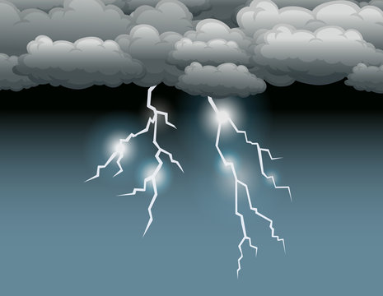
Make a Thunderstorm
Step-by-Step Instructions
As a whole class, make a thunderstorm sound together exploring using different sounds at the same.
For example, some children could clap, some could click, some could stamp their feet, some could rub their hands together, some could play a drum or use any other musical instruments. Get creative! It can be a faraway/quiet thunderstorm if some pupils are sensitive to noise.
Optional: you could take it in turns to have a leader at the front of the group. When the leader lifts their hands high the group gets louder, when the leader puts their hands down low the group gets quieter. Explore any other hand signals like go and stop.

Slide 5
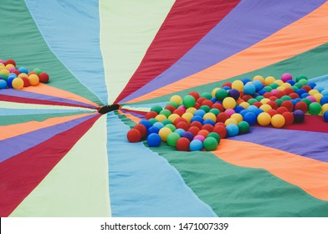
Roly-poly Parachute
Step-by-Step Instructions
PROP: A parachute, or a large blanket or sheet that the children can hold together in a circle.
With children holding on to the parachute, a medium or big ball is placed on it. The group can try to roll it around, working together to make sure it doesn't fall.
They can also try to make the ball bounce, while keeping it on the parachute. Everyone can count how many bounces they achieve and see if they can get more bounces each time!
To add a challenge, use more than one ball on the parachute.

Slide 6
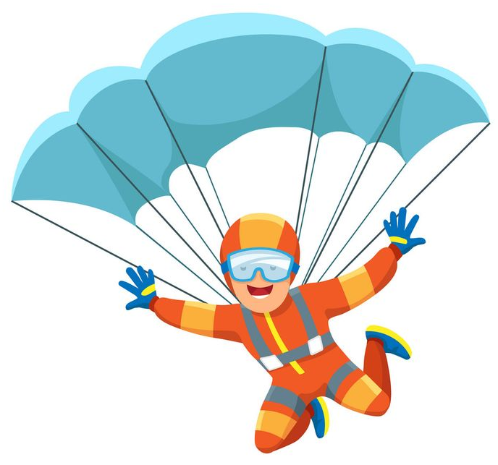
Dancing Parachute
Step-by-Step Instructions
PROP: Music (see below) and a parachute, or a large blanket or sheet that the children can hold together in a circle.
The children stand around the parachute in a circle and lift it up together.
When the music plays, the children make the parachute ‘dance’ by moving it together. It can be nice to try contrasting music, for example:
‘Don’t Stop Me Now’: https://www.youtube.com/watch?v=KKny_ia8Fvo
Piano instrumental: https://www.youtube.com/watch?v=MLbjwFG-Fh0
Each time a member of staff stops the music, the children work together to hold the parachute completely still (like musical statues).

Slide 7
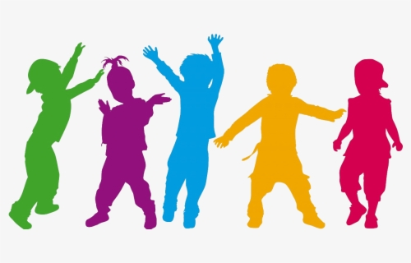
Make a Dance
Step-by-Step Instructions
With everyone in a circle so they can see each other, an adult suggests a simple movement for everyone to try.
Then, participants make suggestions, adding a few more simple steps to the dance sequence.
For example, walking to one side, stepping closer together into the middle of the circle and moving away, spinning once, etc.
You can try the dance to sounds or a favourite song, or use props, e.g. scarves, ribbons, pompons or musical instruments.

Slide 8
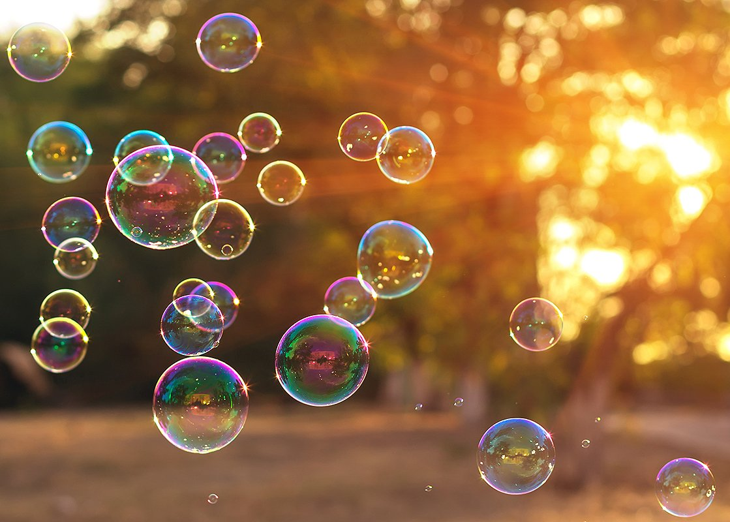
Pop the Bubbles
Step-by-Step Instructions
PROP: Bubble blower or machine.
SUGGESTED MUSIC: https://www.youtube.com/watch?v=9ekY8EvrZmM
An adult blows bubbles into the air while the music is playing. The children start popping the bubbles and when the music stops the children stop popping the bubbles.
Have them pop the bubble with a particular body part, for example: finger, toe, elbow, shoulder, ear.
Change up the game by having them pop them as quickly as they can.

