Slide 1
Year 4 Lesson

Slide 2
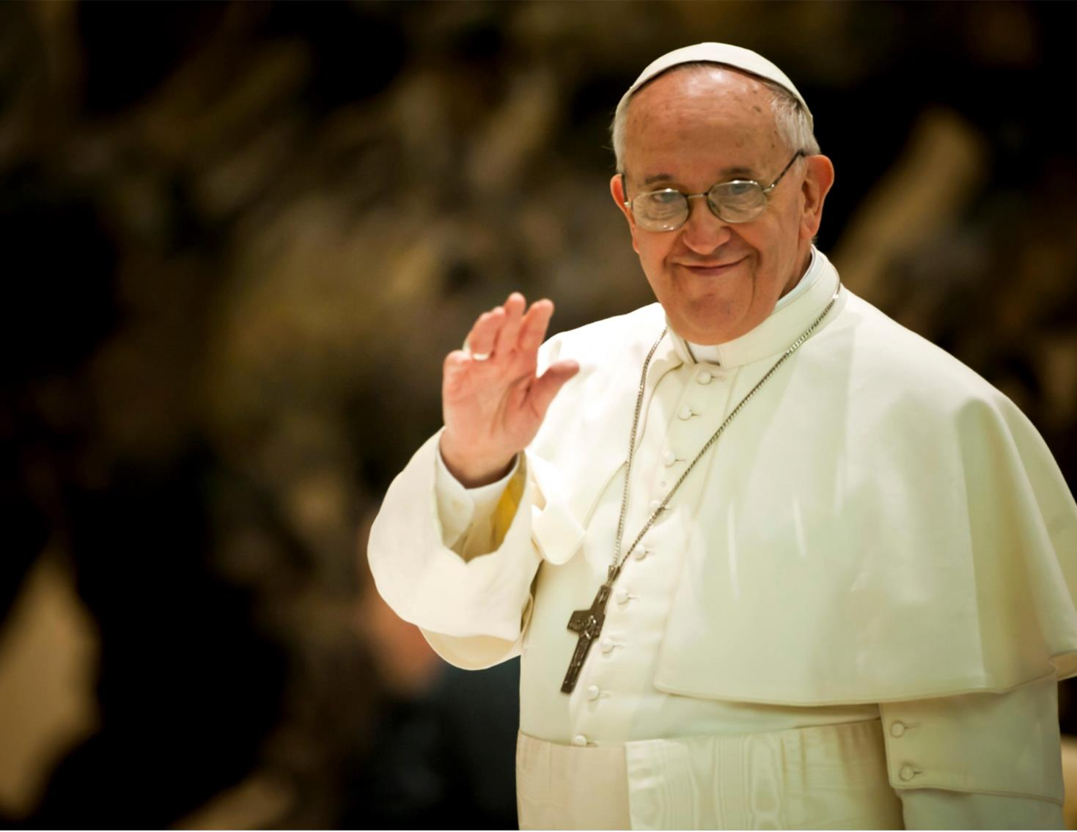
This year’s Lent Appeal is inspired by Pope Francis’s call:
“Build bridges, not walls . . . talk to one another, listen to each other, walk together”

Slide 3
Building Bridges
“Build bridges, not walls.” What do you think Pope Francis means?
How can we “Build bridges, not walls”?
Who can we “Build bridges” with?

Slide 4
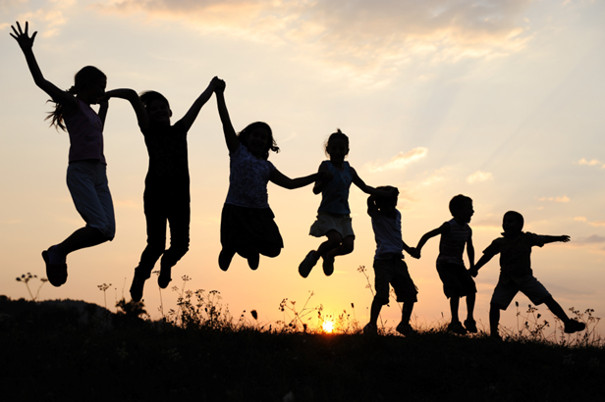
Our Connections
Pope Francis asks us to build bridges and form meaningful connections with others.
Forming positive, healthy and meaningful connections with other people is very important for our mental health and emotional wellbeing.

Slide 5
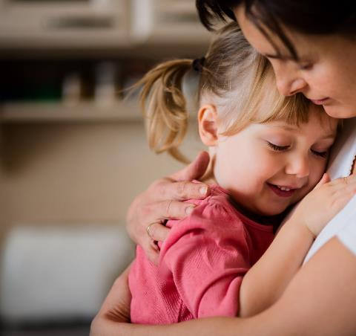
Our Connections
This Lent, we will also be thinking about how we can connect with children and families who need our help.
Our school will be raising money for the Catholic Children’s Society (CCS). CCS is a local charity that helps vulnerable children and families.
During Lent we will learn more about the work of CCS and the children they help.

Slide 6
Our Connections
The Catholic Children’s Society (CCS) is asking you to go on a Lent adventure and connect with others . . .

Slide 7
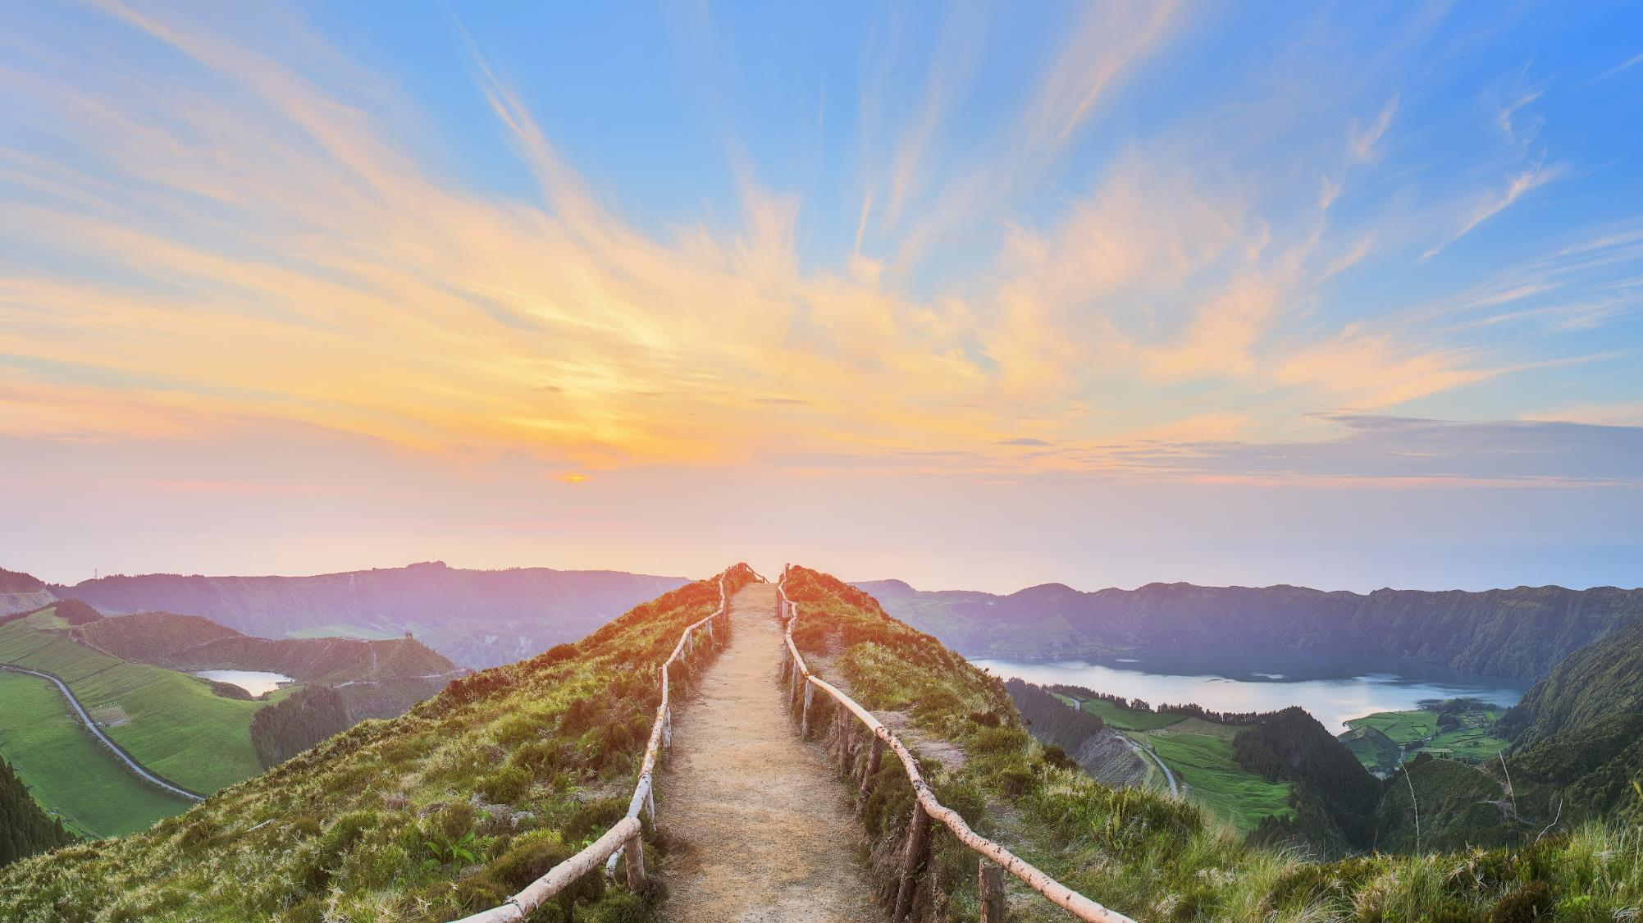
Lent Adventure

Slide 8
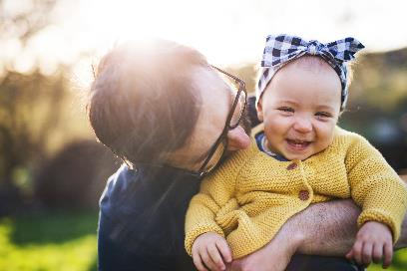
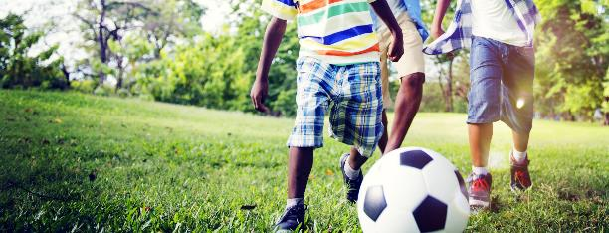
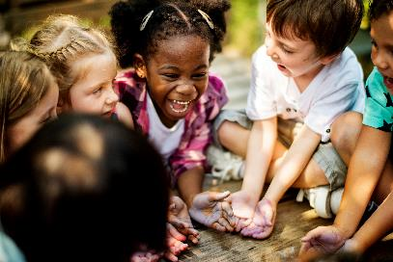
Our Connections
We are about to go on an incredible adventure. On this adventure we will need to connect with other people.
1. Who do you connect with during your week?
2. Who do you connect with during special times in the year?
3. Who do you connect with during your school day?

Slide 9
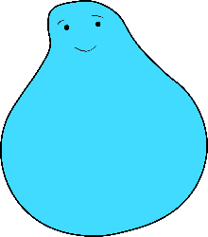
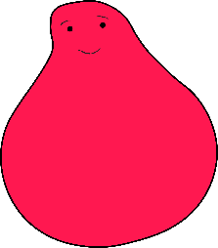
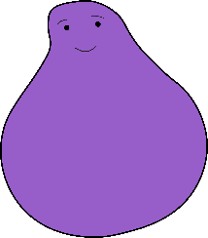
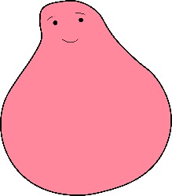
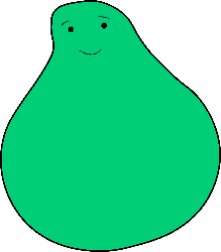
Lent Adventure
We need your help.
A group of children have set off on an exciting adventure…

Slide 10
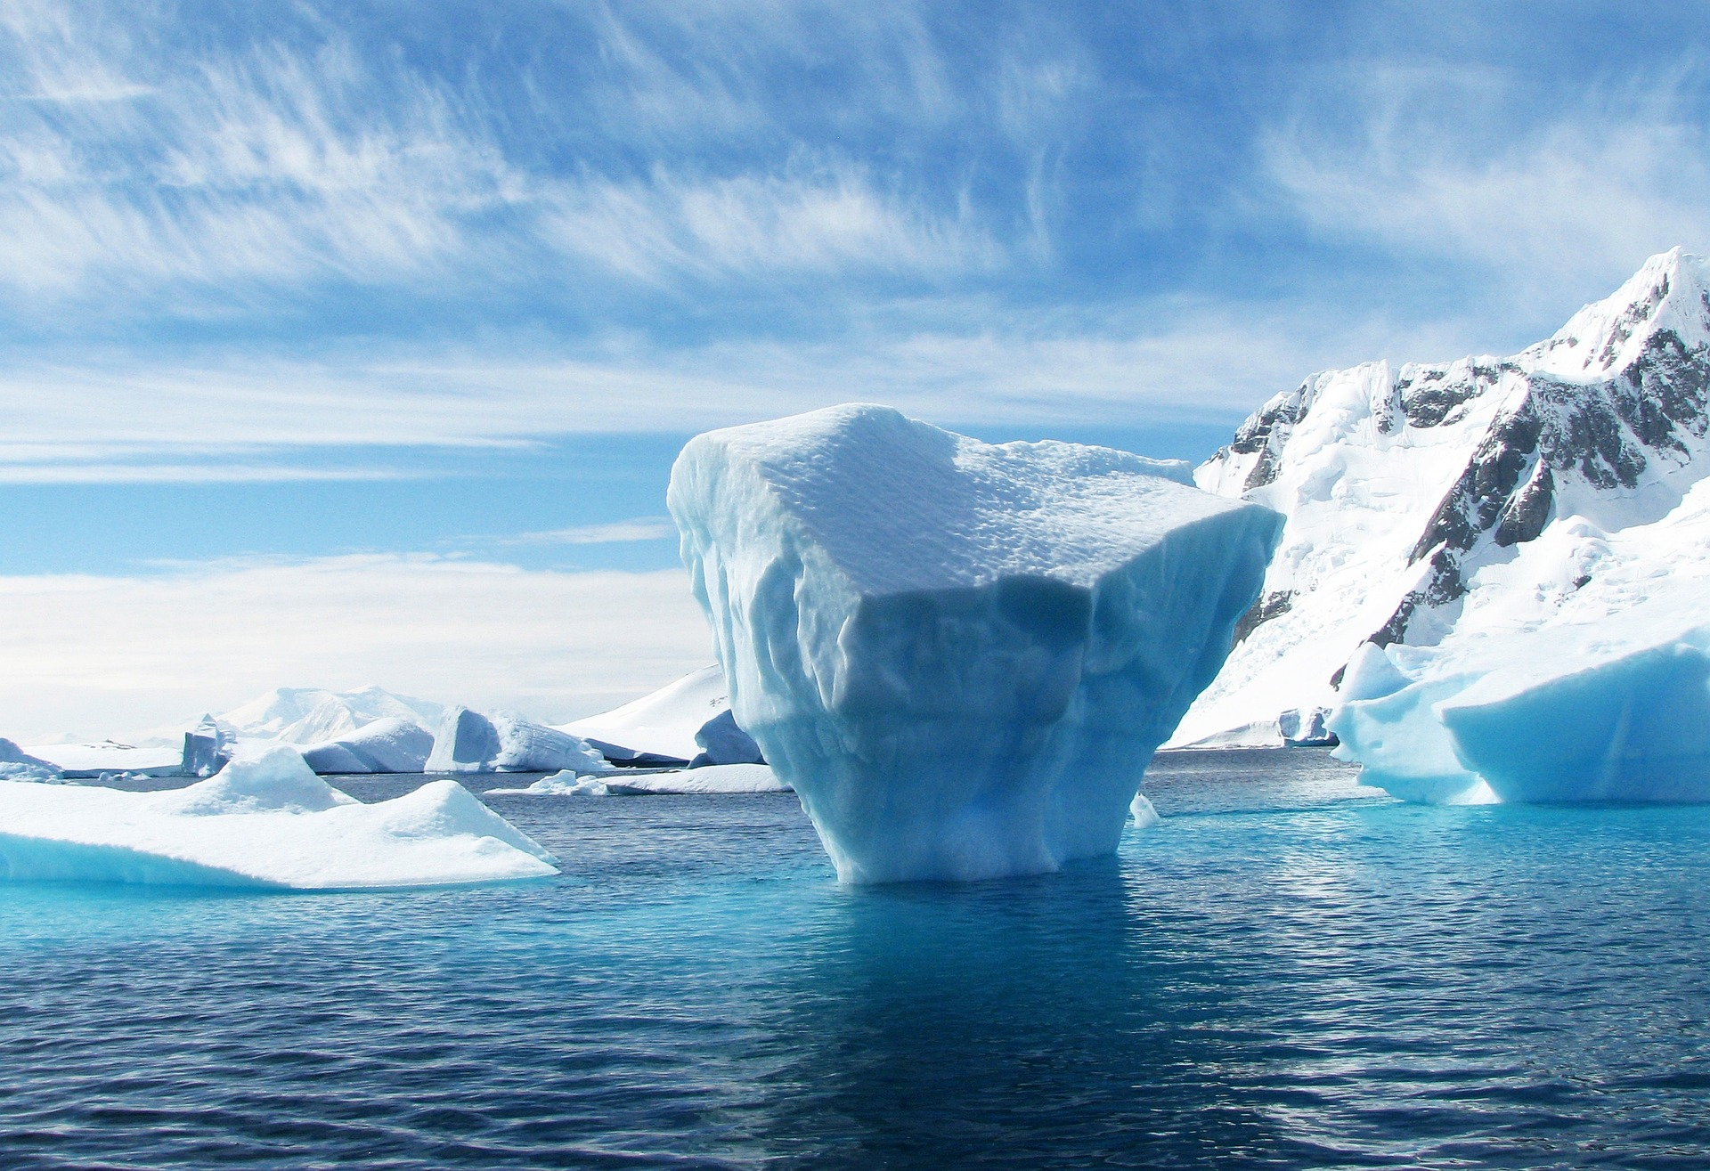
They hopped from freezing icebergs into the deep, dark ocean . . .

Slide 11
They trekked through the vast, sandy deserts . . .

Slide 12
. . . and even glided past magnificent sunsets in a hot air balloon.

Slide 13
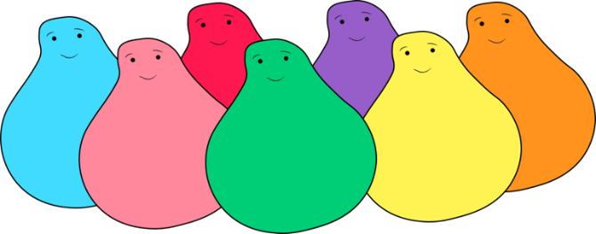
Lent Adventure
Now they want to come home but there is one last bridge to cross.

Slide 14
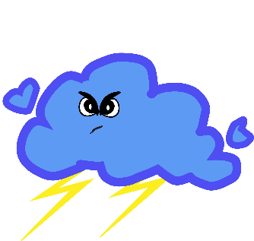
Monsters
Oh no! There are some sneaky monsters on the bridge and they want to stop the children coming home!

Slide 15
Monsters
These monsters creep up on all of us in our lives but we don't always see them coming. They even sneak up on your teachers and head teacher!

Slide 16
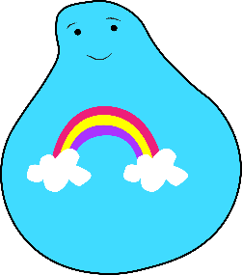
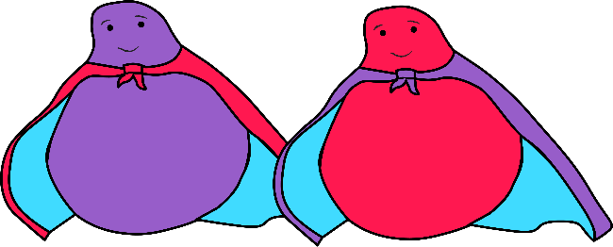
Superpowers
We all have special powers and our powers are the best way to deal with these sneaky monsters. The best thing about these special powers is you can use them to help others too. Each year group is going to use a different special power.
EYFS/Year 1
Year 2
Year 3
KINDNESS
PATIENCE
CURIOSITY
Year 4
Year 5
FUN
COURAGE
Year 6
TEAMWORK

Slide 17
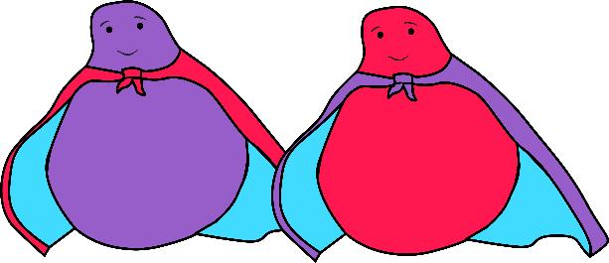
Monsters vs. Superpowers
Each special power is an expert at dealing with specific monsters . . .

Slide 18
Superpowers
Our special power is:
FUN

Slide 19
Fun
As a class, let's think about why our gift FUN is so precious by answering the questions.
1. What does your special power:
Look like?
Feel like?
Sound like?
2. How does it look/sound/feel when different people use it?
3. What is difficult about using this special power?
4. Who do you know uses this special power well? Describe them to me.
5. Do you like using this special power? Why?

Slide 20
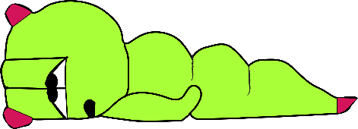
Monsters vs superpowers
Your monster is . . .
BOREDOM MONSTER
Even when you know you have to complete an important job, the boredom monster can sneak up and make you so bored that you just want to give up. Do you know, she can sometimes even make you feel bored doing something that you normally enjoy? It's like she puts a big, dark blanket over all the fun.
Have you ever felt that way?
By using your FUN superpower, you might help the boredom monster feel better. The fun superpower grows from your imagination and it can be shared with others who may need it. By sharing your fun with the boredom monster you give her a boost of energy and she laughs all the boredom away.

Slide 21
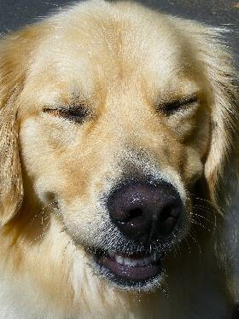
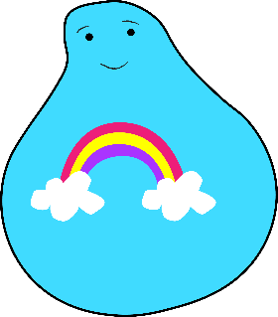
Activity
Smile!
Step-by-Step Instructions
Form a circle, including yourself.
Challenge your group to record the fastest contagious smile ever!
By way of demonstration, start your stopwatch and pass a big smile as you make eye contact with someone across the circle from you.
Once this person smiles at you, start gently jumping up and down to indicate that the first smile has been sent.
The person who received your smile, now passes a smile to a new person in the circle.
The process of passing smiles continues until everyone in the circle has received a smile and passed a smile.
When everyone is jumping on the spot, stop the time.
Play for two or more rounds attempting to record the fastest contagious smile ever.

Slide 22
Well done!
1. How did your special powers help you to connect with others?
2. How did connecting with others help you?
3. What did you find tricky about connecting with others?
Well done! You used your special power FUN to help the children over the bridge and get home!

Slide 23
