Slide 1
Year 5 Lesson

Slide 2
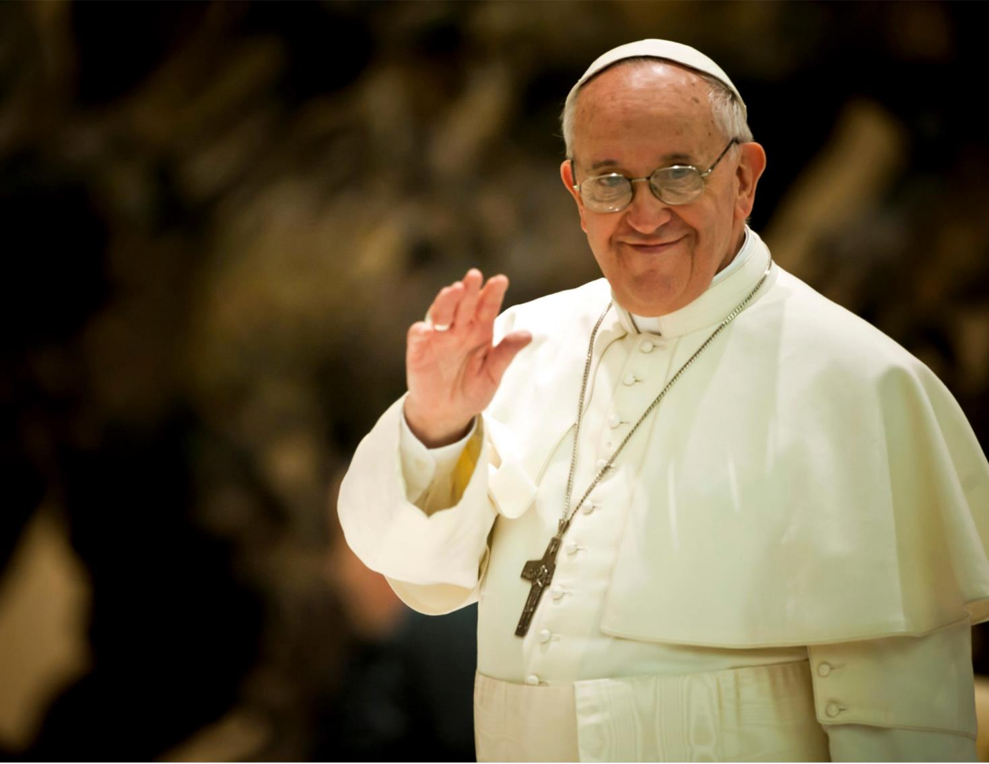
This year’s Lent Appeal is inspired by Pope Francis’s call:
“Build bridges, not walls . . . talk to one another, listen to each other, walk together”

Slide 3
Building Bridges
“Build bridges, not walls.” What do you think Pope Francis means?
How can we “Build bridges, not walls”?
Who can we “Build bridges” with?

Slide 4
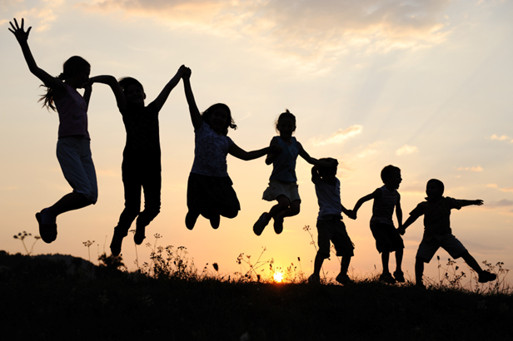
Our Connections
Pope Francis asks us to build bridges and form meaningful connections with others.
Forming positive, healthy and meaningful connections with other people is very important for our mental health and emotional wellbeing.

Slide 5
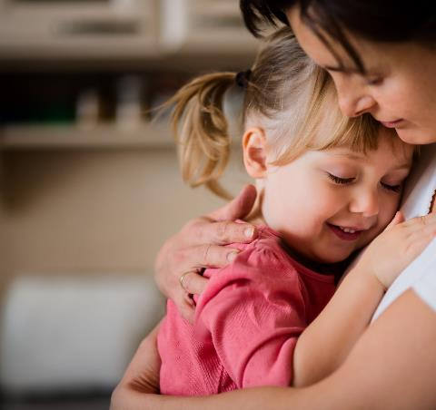
Our Connections
This Lent, we will also be thinking about how we can connect with children and families who need our help.
Our school will be raising money for the Catholic Children’s Society (CCS). CCS is a local charity that helps vulnerable children and families.
During Lent we will learn more about the work of CCS and the children they help.

Slide 6
Our Connections
The Catholic Children’s Society (CCS) is asking you to go on a Lent adventure and connect with others . . .

Slide 7
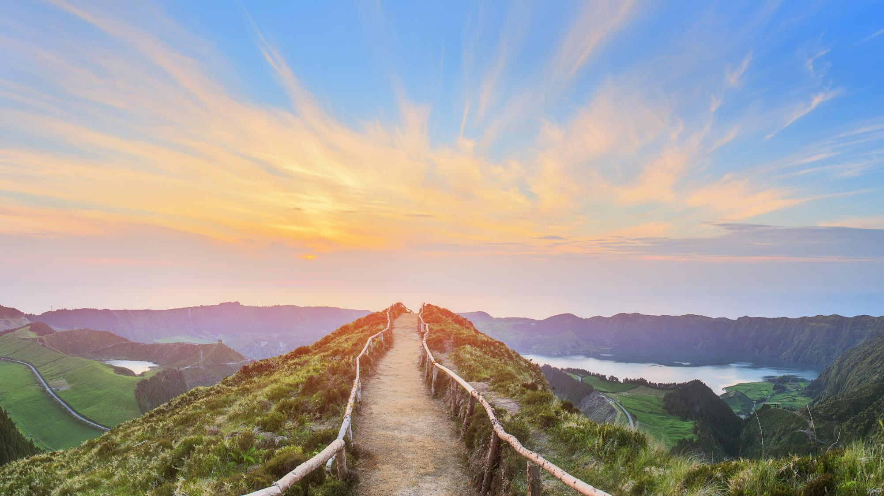
Lent Adventure

Slide 8
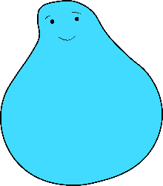
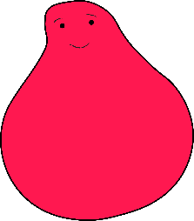
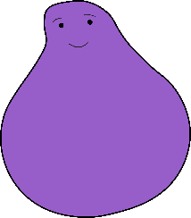
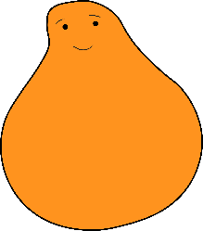
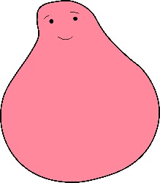
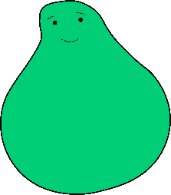
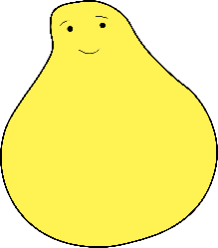
Lent Adventure
We need your help.
A group of children have set off on an exciting adventure…

Slide 9
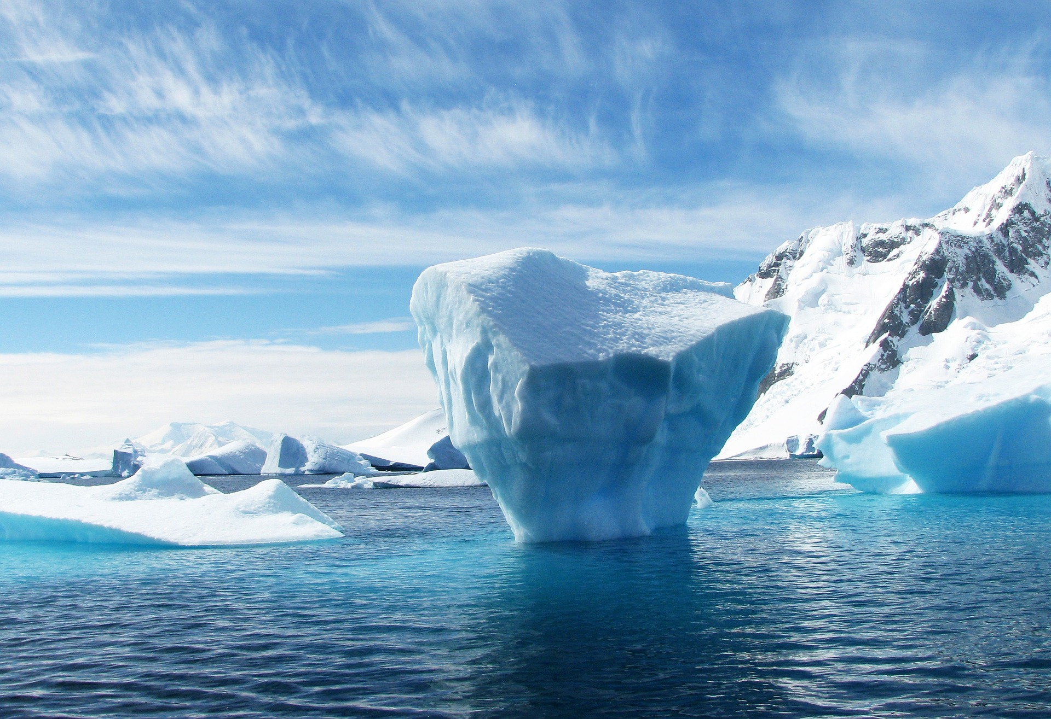
They hopped from freezing icebergs into the deep, dark ocean . . .

Slide 10
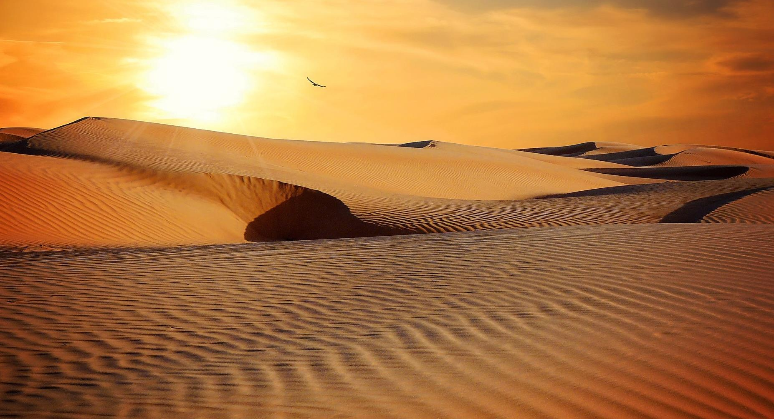
They trekked through the vast, sandy deserts . . .

Slide 11
. . . and even glided past magnificent sunsets in a hot air balloon.

Slide 12
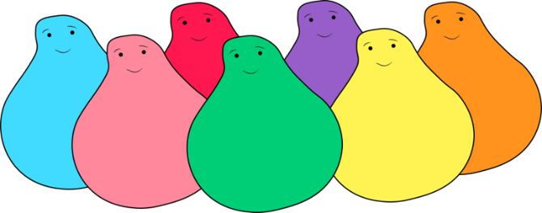
Lent Adventure
Now they want to come home but there is one last bridge to cross.

Slide 13
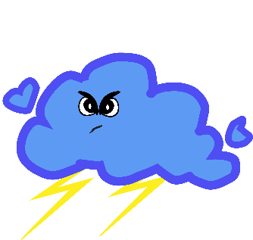
Monsters
Oh no! There are some sneaky monsters on the bridge and they want to stop the children coming home!

Slide 14
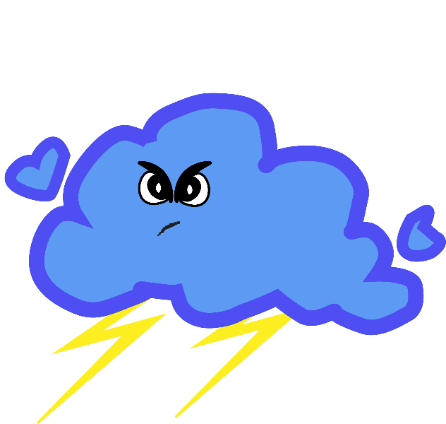
Monsters
These monsters creep up on all of us in our lives but we don't always see them coming. They even sneak up on your teachers and head teacher!

Slide 15
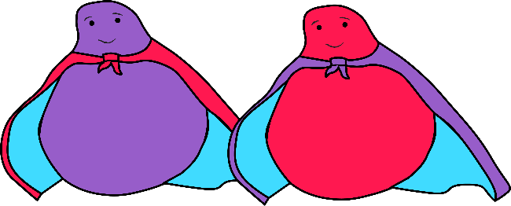
Superpowers
We all have special powers and our powers are the best way to deal with these sneaky monsters. The best thing about these special powers is you can use them to help others too. Each year group is going to use a different special power.
EYFS/Year 1
Year 2
Year 3
KINDNESS
PATIENCE
CURIOSITY
Year 4
Year 5
FUN
COURAGE
Year 6
TEAMWORK

Slide 16
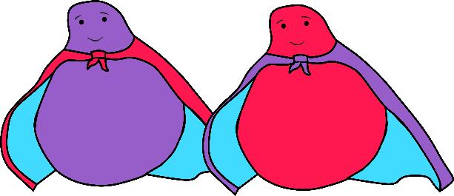
Monsters vs. Superpowers
Each special power is an expert at dealing with specific monsters . . .

Slide 17
Superpowers
Our special power is:
COURAGE

Slide 18
Courage
As a class, let's think about why our gift COURAGE is so precious by answering the questions.
1. What does your special power:
Look like?
Feel like?
Sound like?
2. How does it look/sound/feel when different people use it?
3. What is difficult about using this special power?
4. Who do you know uses this special power well? Describe them to me.
5. Do you like using this special power? Why?

Slide 19
Monsters vs superpowers
Your monster is . . .
DARKNESS MONSTER
This monster loves to make you feel scared. They turn off all the lights, so you don't know where you're going. They make all the sounds and smells around you seem scarier than they were before. Sometimes they make you want to hide and not ask for help. Have you ever felt like that?
But the darkness monster feels scared too and they are frightened to ask for your help. Can you share some of your COURAGE superpower with the darkness monster? The courage superpower shines so bright that it lights up the darkness monster's heart like a torch. Now that you can both see each other a little better, neither of you feel so scared or alone.

Slide 20
Activity
Art Gallery
What does courage mean to you? Who do you think has shown courage? What is a situation that you think you'd need a lot of courage? What does courage look like? What does courage feel like? What does courage sound like?
Use art resources to show what you think courage is. There are no right answers, this is what you think courage is.
Don’t write your name on your work. At the end, the teacher will take the artwork in and display them randomly around the room. The class will then respectfully walk around the room and observe what courage means to different people.
Be Courageous!

Slide 21
Well done!
1. How did your special powers help you to connect with others?
2. How did connecting with others help you?
3. What did you find tricky about connecting with others?
Well done! You used your special power COURAGE to help the children over the bridge and get home!

Slide 22
