Slide 2
This year’s Lent Appeal is inspired by Pope Francis’s call:
“Make your voices heard! If they do not listen to you, shout even louder, make noise.”

Slide 3
Let’s think about voice
Why is it important for you to share your voice?
When do you feel comfortable sharing your voice?
What is difficult about sharing your voice?

Slide 4
Let’s think about voice
It is important for you to share your voice and express yourself. ​
​
Sometimes this can be hard for us to do.​
​
We might feel scared or embarrassed or like what we have to say isn't important.​
​ But your voice is important. You have the right to be heard. The following activities will help you to express yourself. We want to hear your voices!

Slide 5
Pope Francis call us to . . .
“Make your voices heard!”
How can we do this?

Slide 6
Activity 1
Everyone close your eyes!
If your teacher taps you on the head, say ‘hello’
Everyone else in the class shout out the name of who you think said hello
Can you guess who spoke by the sound of their voice? How did you know it was that person?

Slide 7
What does this activity teach us?
This activity shows us that we can recognise people from only their voices. It’s important to use your individual voice and speak up!

Slide 8
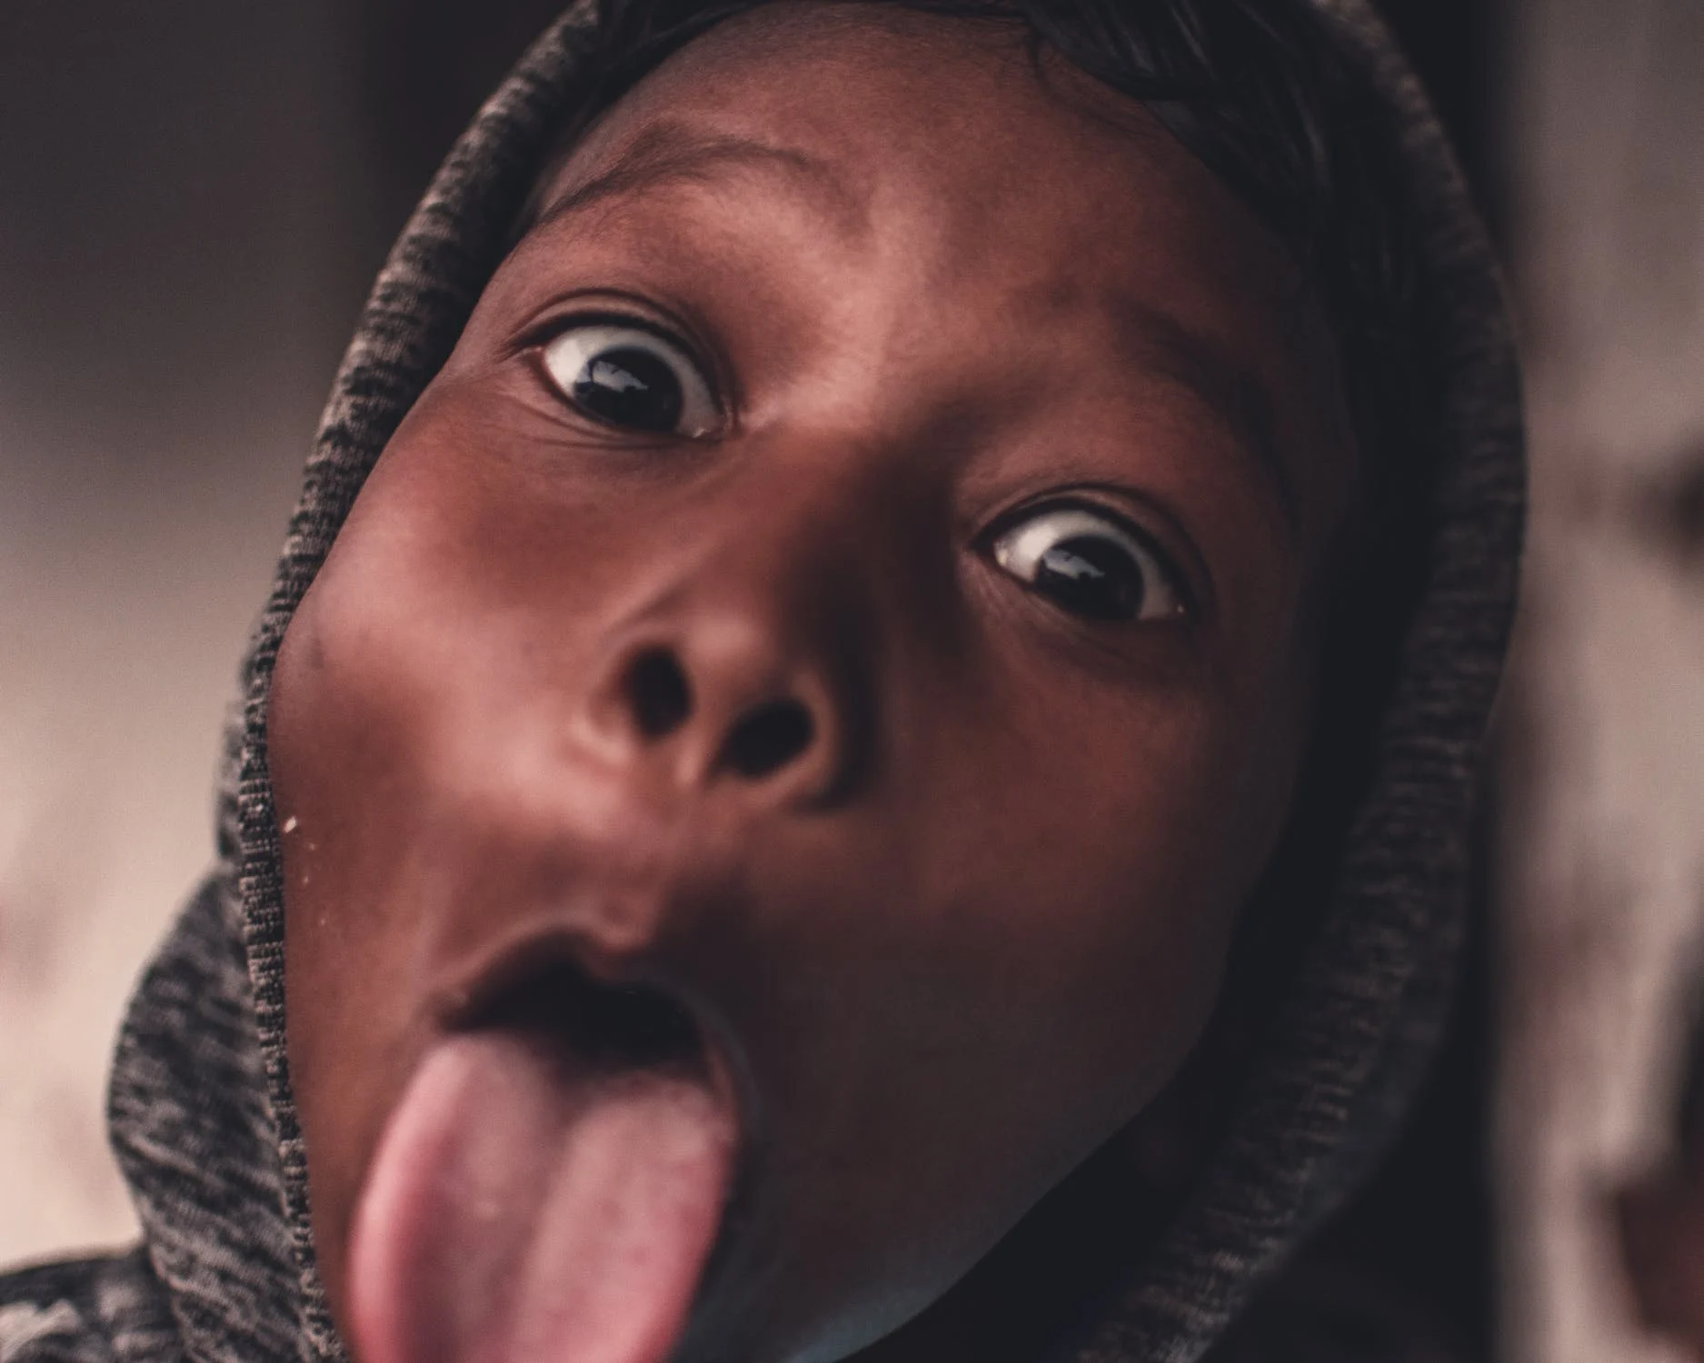
Activity 2
Your teacher will split you into pairs
Your teacher will give one person in your pair an emotion. Try and show this emotion only by using your face. The other person needs to try and guess what the emotion is
Then swap!

Slide 9
What does this activity teach us?
This activity shows that you can express how you feel not only through voice but through your face too! Sometimes it is hard to say how we feel, but we can let our friends and family know through the expressions on our faces.

Slide 10
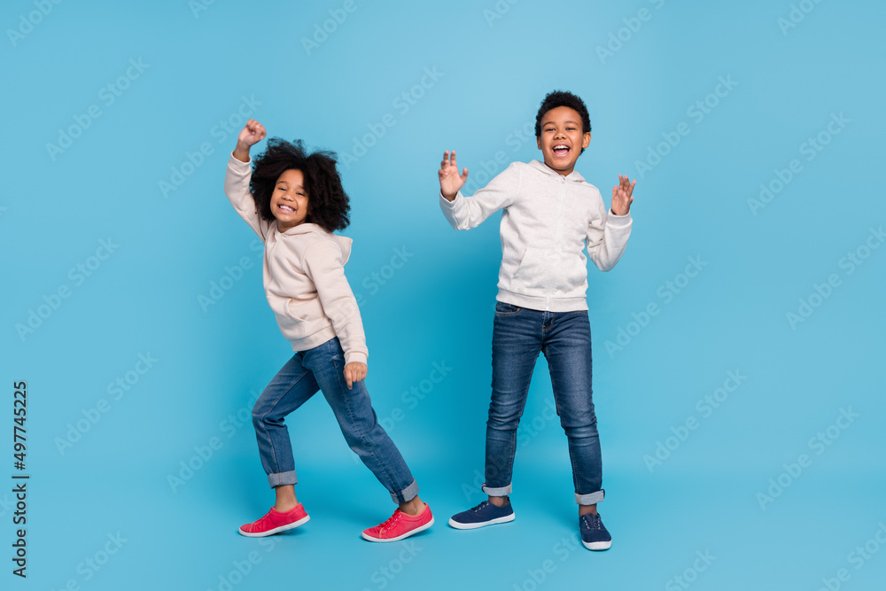
Activity 3
It is important for you to share your voice and express yourself. ​
​
Your teacher will split you into small groups.
Your teacher will ask you to use art, dance or writing.
Through art, dance or writing, try to communicate the word VOICE
After 10 minutes feedback to your class.

Slide 11
What does this activity teach us?
This activity teaches us that voice doesn’t always have to mean words.
We can make our voices heard and express ourselves in lots of different ways!

Slide 12
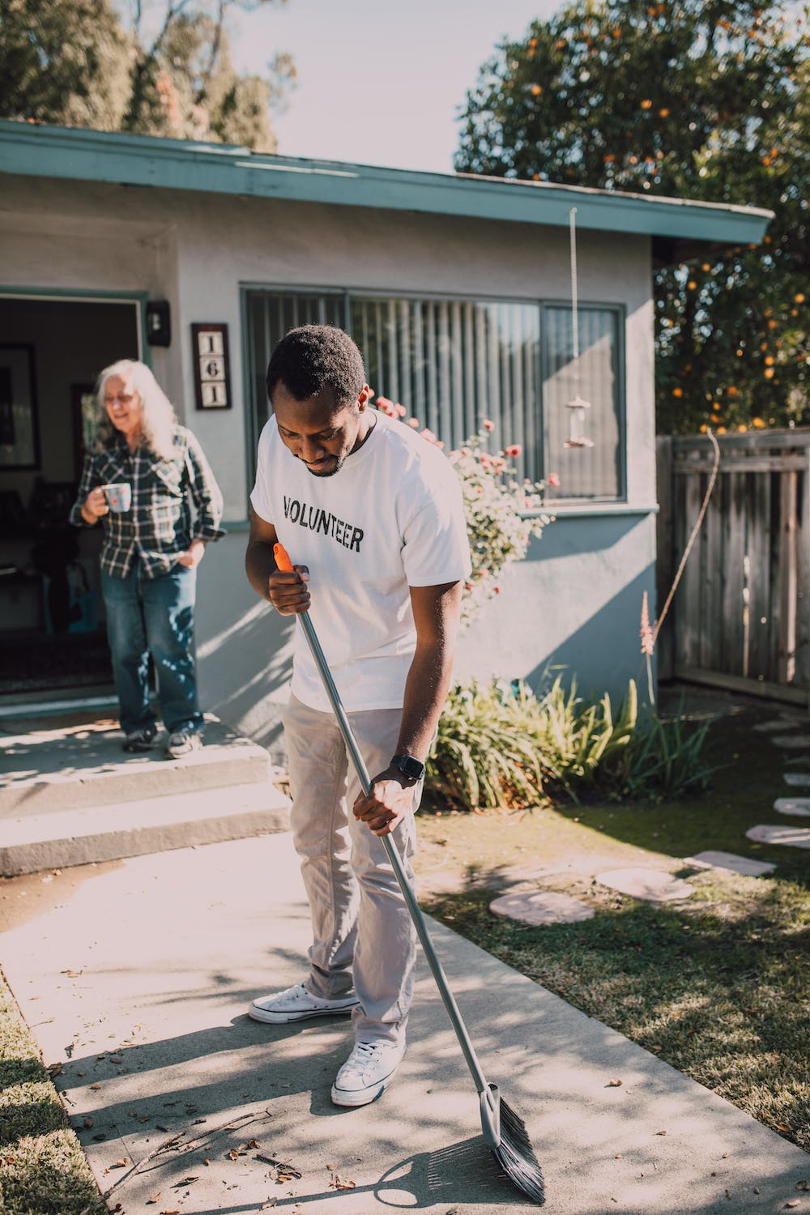
Activity 4
Your teacher will go around the class and ask each of you to say one thing that you can do to help someone else
Try and think of something different from the people before you
Take your time. It might be hard to think of something different!

Slide 13
What does this activity teach us?
This activity encourages us to use our voice to think about other people. It is important to use your voice to say what you want and need, but it is also important to use your voice to help others have what they want and need.

