Slide 2
This year’s Lent Appeal is inspired by Pope Francis’s call:
“Make your voices heard! If they do not listen to you, shout even louder, make noise;
you have every right to have your say on what concerns your future. I encourage you
to be enterprising, creative, and critical.”

Slide 3
Let’s think about voice
Why is it important for you to share your voice?
When do you feel comfortable sharing your voice?
What is difficult about sharing your voice?

Slide 4
Let’s think about voice
UN Convention on the Rights of the Child
Article 12:​
You have the right to an opinion and for it to be listened to and taken seriously.
You have freedom of expression and can make your voice heard!

Slide 5
Pope Francis call us to . . .
“Make your voices heard!”
How can we do this?

Slide 6
Activity 1: Thinking about the future
Let’s start by thinking where you see yourself in 5 years time.
Talk in pairs for 5 minutes about what you want for yourself in 5 years time. You could think about what job you would like, where you want to live, what hobbies you will have and anything else you would like to add!
Feedback to your classmates.

Slide 7
What does this activity teach us?
This activity prompts you to think about your future and what you want to do with it. You have the right and responsibility to control your life and your future.

Slide 8
Pope Francis says . . .
“I encourage you to be enterprising”
How can we do this?

Slide 9
Activity 2: Enterprising
Now you have thought about and discussed where you would like to be in 5 years' time, let’s think about how you can best make this happen.
In your pairs discuss for 5 mins the following questions: Do you have the resources you need to achieve this? Can you ask a teacher for help to reach your goal? Who else could you get to help you? How can you prepare and best equip yourself to reach your goals?
Feedback to your classmates.

Slide 10
What does this activity teach us?
This activity encourages us to be enterprising. Think about what you need to make your dreams for the future possible, and use your voice to ask for it and make it happen!

Slide 11
Pope Francis says . . .
“I encourage you to be creative”
How can we do this?

Slide 12
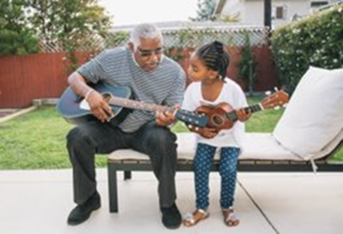
Activity 3: Creative
How can you express your voice and your goals differently?
In your pairs discuss for 5 mins the following questions: What are the different ways in which you can make your voice heard? E.g. art, dance, music, petitions, charity work etc. Why do you think these different forms of expression are effective? In what scenarios would they be the most effective?
Feedback to your classmates.

Slide 13
What does this activity teach us?
This activity encourages us to be creative. Voice can mean multiple things and be expressed in different ways.
You can make your mark and shape your future in alternative ways to just asking. You can express your voice differently, boldly and loudly to achieve what you want.

Slide 14
Pope Francis says . . .
“I encourage you to be critical”
How can we do this?

Slide 15
Activity 4: Critical
So far we have been very focused on you, your life and your future, now lets think more broadly and outside the box.
Individually make a mind map of 5 things you want in the future that aren’t personal to you. For example: What do you want for the future of society? What about the future of the environment?
Feedback to your classmates.

Slide 16
What does this activity teach us?
This activity encourages us to be critical. It is important to think critically, deeply or differently about the future as a whole, not just your individual future.
Some of this can be quite scary to think about, but it’s important to not only use your voice for yourself, but to promote the wellbeing and future of others.

