Slide 1
Notes:
Hi I’m Anna and I’m from a charity called Catholic Children’s Society or CCS for short
I’m speaking to you today because your school is raising money as part of our Lent Appeal to help us help other children like you. So I’m saying a big thank you because the money will make a big difference.

Slide 2
Who are CCS?
CCS is a charity helping local disadvantaged children and families
We work with all faiths and none across London, Hertfordshire and the Southeast
Through our early intervention improve children’s life chances
Notes:
I’m going to tell you a little bit about the Catholic Children’s Society as you might not know about us. We help children and families in all sort of different ways, we can help children feel better when they’re feeling sad, we can help children get a better education and make children feel happier and more confident. We’re called the Catholic Children’s Society and we are a catholic charity, but we help all children, no matter what religion you follow, or if you’re not religious at all.

Slide 3
This year’s Lent Appeal is inspired by Pope Francis’s call:
“Make your voices heard! If they do not listen to you, shout even louder, make noise;
you have every right to have your say on what concerns your future. I encourage you
to be enterprising, creative, and critical.”
Notes:
I’m here today to talk to you about our Lent Appeal, which your school has signed up to help us fundraise for. So this year’s CCS Lent Appeal is inspired by the words of Pope Francis - “Make your voices heard! If they do not listen to you, shout even louder, make noise; you have every right to have your say on what concerns your future. I encourage you to be enterprising, creative, and critical.”

Slide 4
What does Pope Francis mean?
Notes:
So, what does Pope Francis mean by this?

Slide 5
“Make your voices heard! If they do not listen to you, shout even louder,
make noise;
you have every right to have your say on what concerns
your future. I encourage you
to be enterprising, creative, and critical.”
Notes:
So, in this quote Pope Francis is saying about the importance of your voice and being listened to. Pope Francis says about the ways you can do this, by being enterprising, creative, and critical.
We have resources on our website you can go through with your teacher to think about this more and how you can use your voice to make a difference in the world.

Slide 6
What does CCS do?
Notes:
You will also be making a difference by raising money for CCS this Lent. The money you raise will be used to help local children and young people like you. We have different ways of helping children.

Slide 7
What does CCS do?
We have two family centres: St Mark’s Stay & Play and St Francis
We provide early years development and support for disadvantaged children
We also offer help and advice to the parents and carers
Notes:
So firstly, we run two family centres for children aged 0-4. We run a nursery and support parents facing many different challenges who might need help with problems like housing or finding a job.

Slide 8
What does CCS do?
Counselling and therapy for children with complex mental health needs
Mental health training for school staff
Rainbows, a bereavement support programme to help children who have experienced a loss in their lives
Notes:
Next, we have our Connect-Ed counselling and therapy services to support children’s mental health.
We also have our Rainbows Bereavement Support Programme which trains school staff to help children who are struggling with a loss in their lives.

Slide 9
What does CCS do?
Our Crisis Fund provides emergency funding for families in crisis situations
Headteachers can apply to our Crisis Fund and we respond within 24 hours
We provide food and essential items when families have nowhere else to turn
Notes:
Finally, we have our Crisis Fund. We help when children and their families are really struggling and they don’t know where to turn to for help. They might be facing homelessness, they might be sleeping on the floor because they have no beds, or living in a freezing home because the family cannot afford the cost of heating. That’s when we can be there with our Crisis Fund to support them. We can give children and their families some money to help them to get the things they need to make life better for them and happier. Like beds to sleep in, warm clothes, a cooker to make hot meals or help with gas and electricity bills. And your money will help more children with things like this.

Slide 10
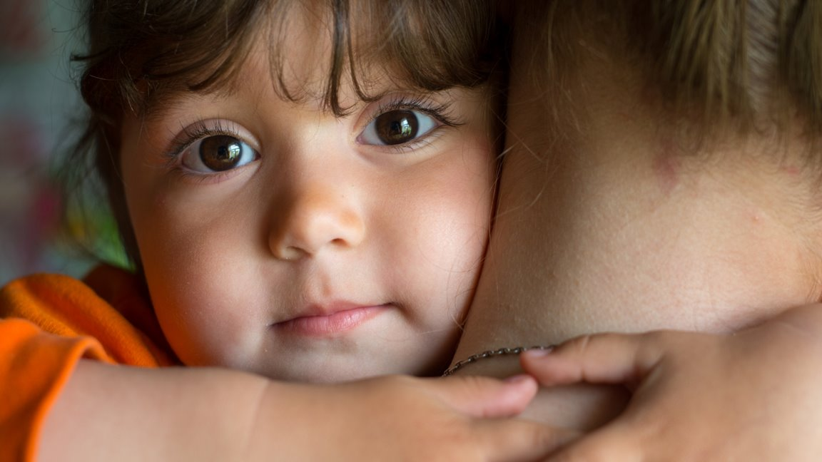
Ellie’s Story
Notes:
We are now going to look at a recent Crisis Fund story, to help you understand more about how your fundraising for CCS can really help.
We were able to help Ellie with the money raised by schools last Lent.

Slide 11
Ellie’s Story
Ellie is six years old and lives with her mum.
Ellie’s mum has two jobs, works long hours and doesn’t get paid very much but she has always had enough money to pay for rent and food.

Slide 12
Ellie’s Story
Last year Ellie woke up and found a rat in her room. Ellie’s mum saw rats in the rest of the house.
An inspector came to their home and told Ellie and her mum that there were so many rats that they would have to leave that day.

Slide 13
Ellie’s Story
Ellie and her mum were told they would have to stay in a hostel just for a few days. Six months later they were still there.
The hostel was not nice. Ellie and her mum shared a small room. There was no kitchen so Ellie’s mum couldn’t cook and they shared a dirty bathroom with lots of other people at the hostel.

Slide 14
Ellie’s Story
Eventually, Ellie and her mum were moved into a new flat.
But when they moved in, they saw that it was completely empty – there was no fridge, no cooker, no chairs . . . not even beds to sleep in. Ellie and her mum slept in their coats on the floor.

Slide 15
Ellie’s Story
Ellie went to school every day feeling very tired and sad and she couldn’t focus on her work.
Ellie’s teacher found out what was happening and Ellie’s mum said that she didn’t have enough money to even buy a pillow.

Slide 16
Ellie’s Story
Ellie’s school contacted the Catholic Children’s Society to see if we could help.​
The next day, we used money raised by schools to help the family buy beds, bedding, chairs, a cooker and a fridge! ​

Slide 17
Ellie’s Story
Now Ellie and her mum can eat fresh, home cooked meals together and sleep in their own clean and cosy beds.
Ellie is much happier and healthier and can now concentrate at school again.

Slide 18
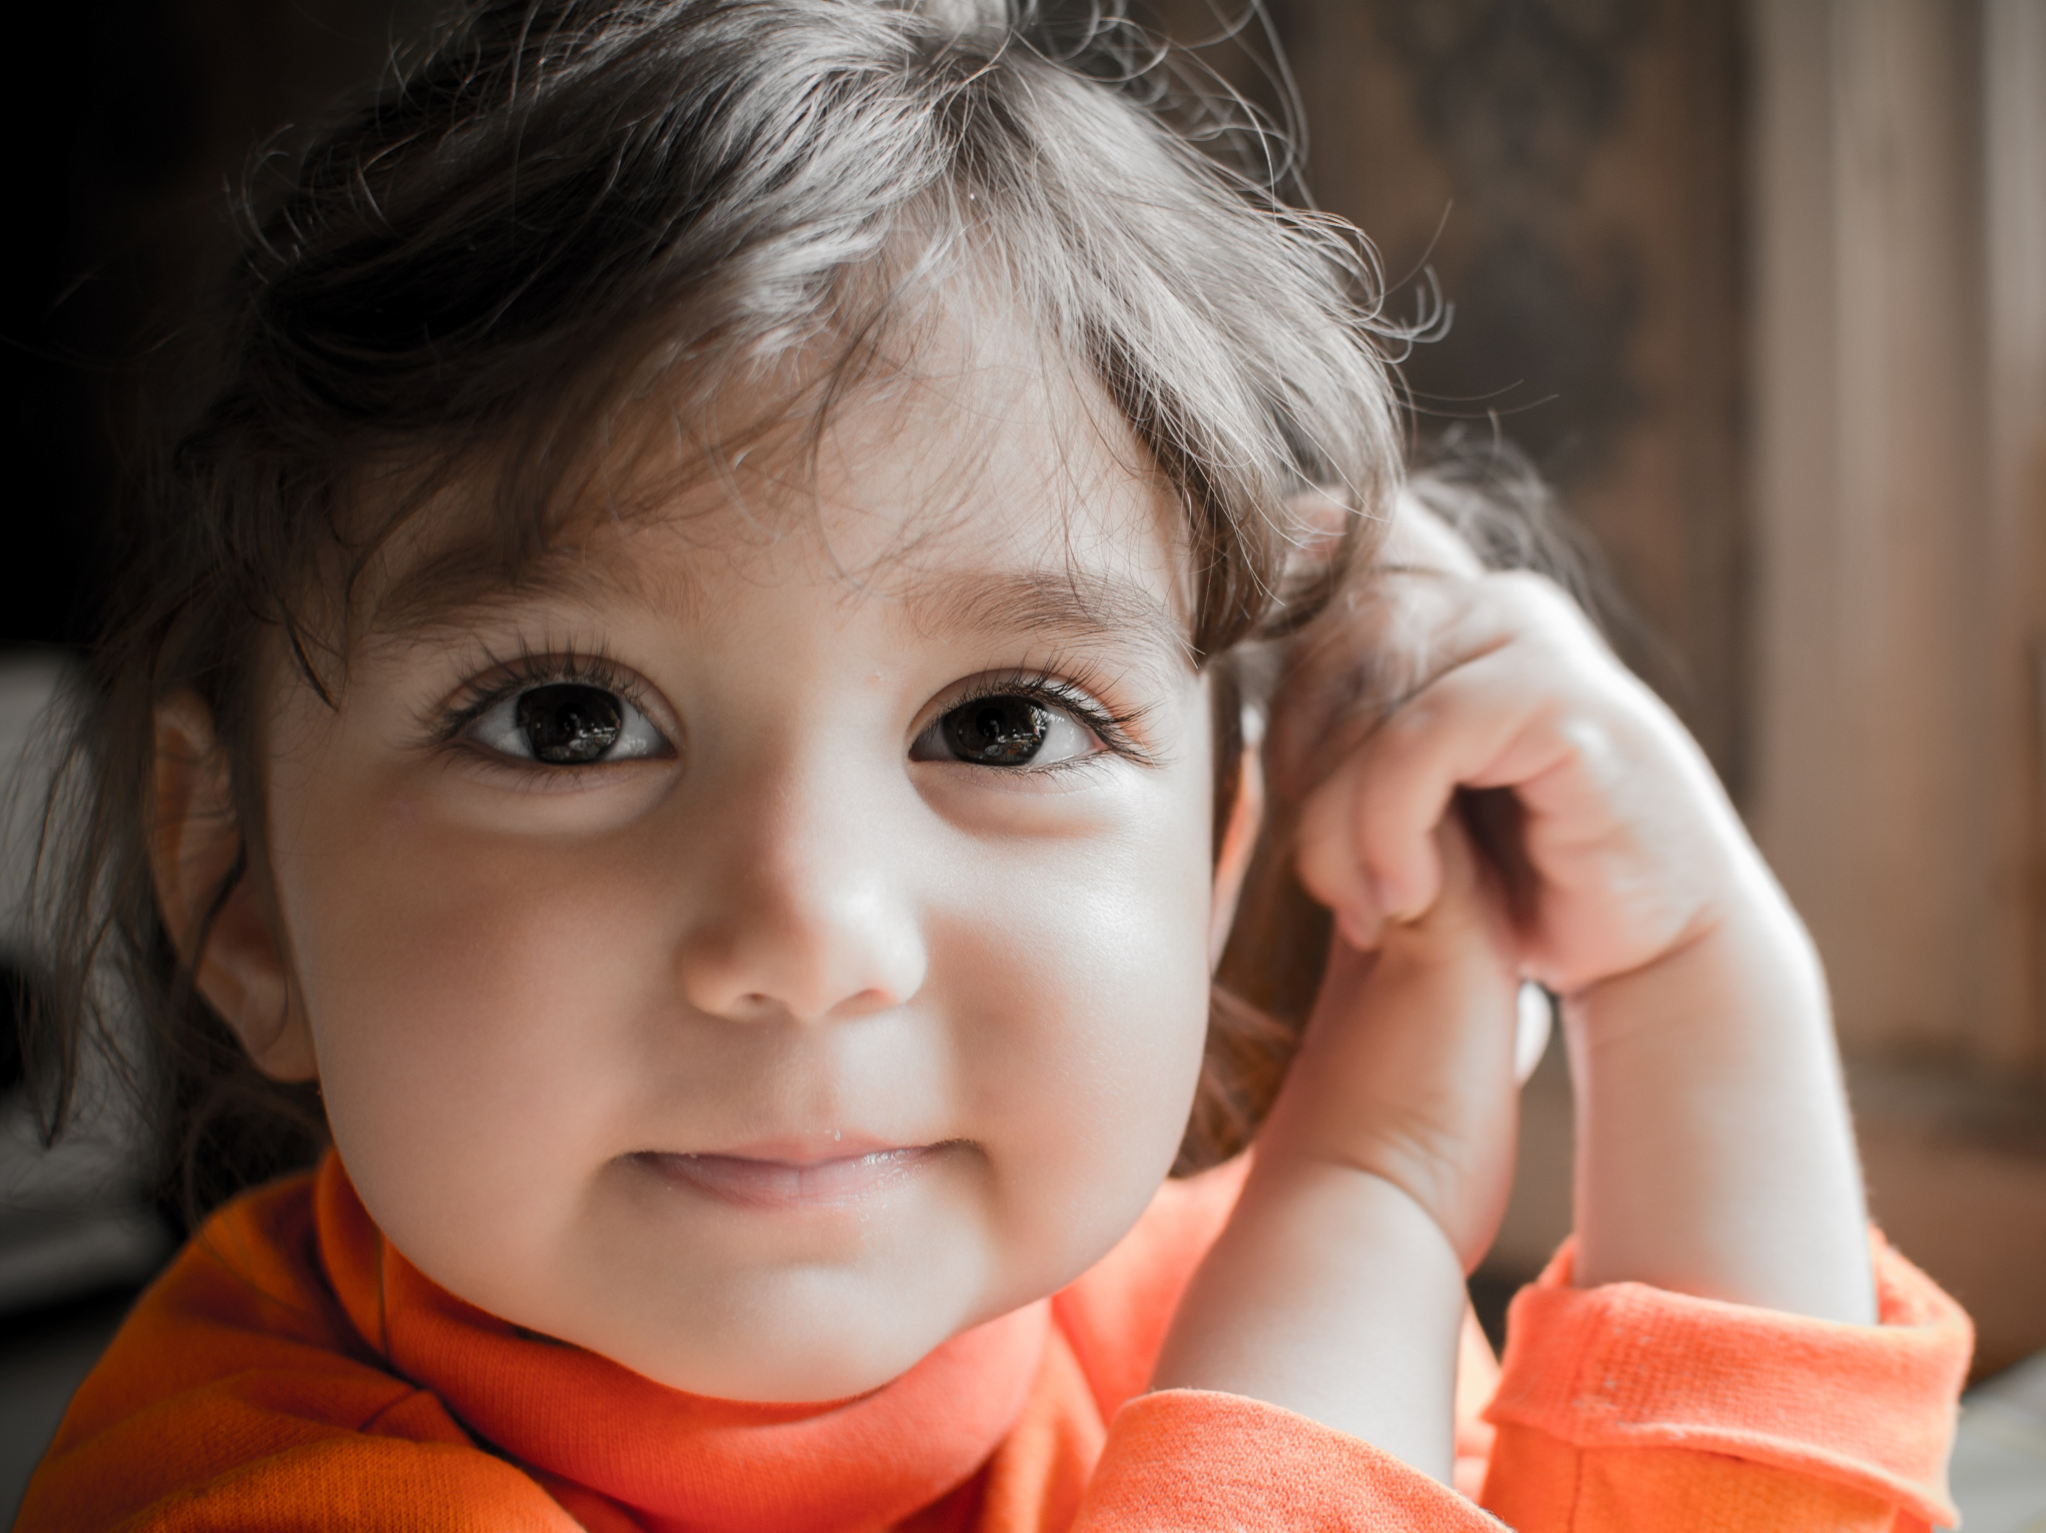
Ellie’s mum said:
“Thank you so much for helping me and my daughter. . .
your help has changed our lives.”

Slide 19
Fundraising for CCS
Bake sale or bake-off competition, doughnut shop
Quiz night, talent show, school auction
Sports tournament e.g. football match, fun run, mini olympics
Non-uniform day, football t-shirt day, fashion show
Notes:
Now I’m sure you all have lots of ideas of how to raise money, but here are a few ideas to get you started. Some good ideas that other schools have used in the past are a bake sale, non-uniform day and a quiz night!

Slide 20
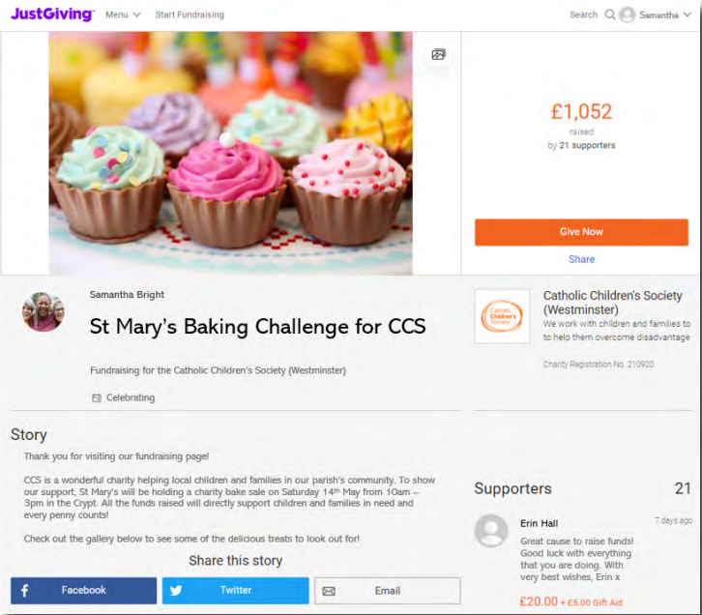
Fundraising for CCS
JustGiving online fundraising page is quick and easy way to start fundraising
This way you can keep your community updated with your fundraising journey
Notes:
You will be given boxes to collect the money you have raised, but another good way of receiving donations is through a fundraising page, like with JustGiving. If you want to do this ask a teacher or parent for help.

Slide 21
Fundraising for CCS
By raising awareness, you can gather more support
Share your fundraiser through posters, school newsletters, information for parents and online!
Notes:
Let people know you are fundraising to raise more money, such as through posters in school, in your school newsletter or online, such as through JustGiving.

Slide 22
Fundraising for CCS
Top Tips
Create an online donation page ​
Ask parents, staff and governors to help ​
Make a week-long fundraiser and organise different activities ​
Share your fundraiser through the school newsletter and social media ​
Thank your sponsors to encourage donations

Slide 23
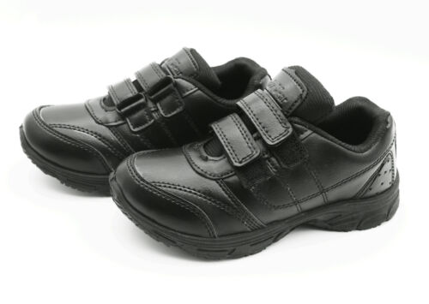
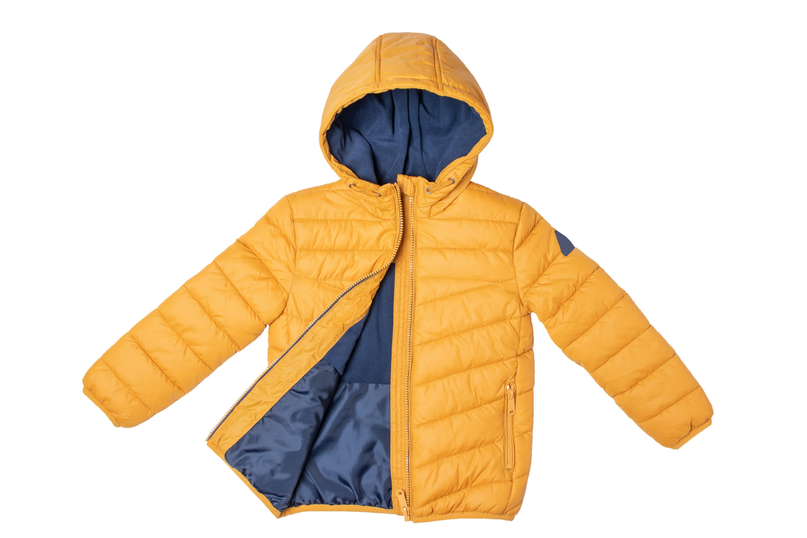
How does your support make a difference?
£15 can buy a child a pair of shoes
£25 can buy a coat to keep a child warm
£50 can buy food to feed a family for a week
£100 can buy a bed to help a child sleep at night
Notes:
Every penny you raise will go towards our work helping children and young people in need. Just to give you an idea of the things we can buy with the money you raise . . .

Slide 24
Prayer
Dear Lord,
Guide us this Lent as we work together to build bridges and help everyone in our community.
Let us think about those children and families in need. Give us strength as we work to help them and bring comfort and hope to their lives.
Amen
Dear Lord,
Guide us this Lent as we use our voice to make a difference.
Let us think about those children and families in need. Give us strength as we work to help them and bring comfort and hope to their lives.
Amen

Slide 25
Thank you for listening! With your school’s support this Lent, we will help more children and families in need.
Notes:
I just want to say a really big thank you again to all of you here in school, for raising money for the Catholic Children’s Society’s Lent Appeal to help local children and young people in need.

