Slide 1
Notes:
Hi I’m Anna and I’m from a charity called Catholic Children’s Society or CCS for short
You are watching this presentation today because your school is raising money as part of our Lent Appeal to help us help other young people like you. So I’ve come to say a big thank you because the money will make a big difference.

Slide 2
Who are CCS?
CCS is a charity helping local disadvantaged children and families
We work with all faiths and none across London, Hertfordshire and the Southeast
Through our early intervention improve children’s life chances
Notes:
If you don’t already know about the Catholic Children’s Society here’s a little bit about who we are and what we do. Firstly, we are Catholic charity inspired by Catholic Social Teaching but we help all children and families, of all faiths and none.

Slide 3
This year’s Lent Appeal is inspired by Pope Francis’s call:
“Make your voices heard! If they do not listen to you, shout even louder, make noise;
you have every right to have your say on what concerns your future. I encourage you
to be enterprising, creative, and critical.”
Notes:
I’m here today specifically to talk to you about our Lent Appeal, which your school has signed up to help us fundraise for. So this year’s CCS Lent Appeal is inspired by the words of Pope Francis - “Make your voices heard! If they do not listen to you, shout even louder, make noise; you have every right to have your say on what concerns your future. I encourage you to be enterprising, creative, and critical.”

Slide 4
What does Pope Francis mean?
Notes:
So, what does Pope Francis mean by this?

Slide 5
“Make your voices heard! If they do not listen to you, shout even louder,
make noise;
you have every right to have your say on what concerns
your future. I encourage you
to be enterprising, creative, and critical.”
Notes:
So, in this quote Pope Francis is expressing the importance of your individual voice. You have every right to have your say on the things that concern you, and you shouldn’t be afraid to make your voice heard. Pope Francis encourages you to be enterprising, creative and critical to achieve this.
You also have a pack of resources you will be going through with your teacher to think about Pope Francis’s call more deeply, what he means by enterprising, creative and critical, and how this call can relate to you and your life specifically.

Slide 6
What does CCS do?
Notes:
The money you raise for us will be used to massively help young people like you. We’re here to help children and young people in the greatest of need and we have different services to help with different needs. Here’s a bit of an overview of what we do and how your fundraising can help.

Slide 7
What does CCS do?
We have two family centres: St Mark’s Stay & Play and St Francis
We provide early years development and support for disadvantaged children
We also offer help and advice to the parents and carers
Notes:
So firstly, we run two family centres for children aged 0-4. We run a nursery and support parents facing many different challenges such as food poverty and families at risk of homelessness.

Slide 8
What does CCS do?
Counselling and therapy for children with complex mental health needs
Mental health training for school staff
Rainbows, a bereavement support programme to help children who have experienced a loss in their lives
Notes:
Next, we have our Connect-Ed counselling and therapy services to support children’s mental health and wellbeing.
We also have our Rainbows Bereavement Support Programme which helps to train school staff support pupils who have experienced a loss in their lives.

Slide 9
What does CCS do?
Our Crisis Fund provides emergency funding for families in crisis situations
Headteachers can apply to our Crisis Fund and we respond within 24 hours
We provide food and essential items when families have nowhere else to turn
Notes:
Finally, we have our Crisis Fund. Every single penny you raise for the Catholic Children’s Society will go into the Crisis Fund and directly help local young people in crisis. Headteachers apply on behalf of a family in crisis – they could be facing homelessness, fleeing domestic violence or struggling with the illness or death of a loved one. We respond within 24 hours to provide whatever help the family most needs – this could be physical household objects like beds, fridge or clothes, or financial help with rent or gas and electric bills.

Slide 10
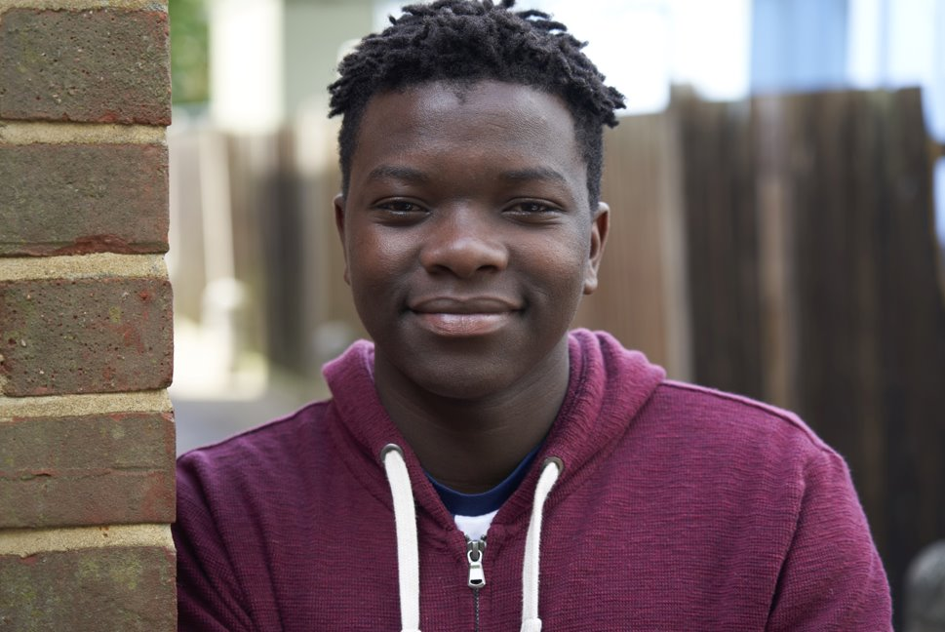
Daniel’s Story
Notes:
We are now going to look at a recent Crisis Fund case, to help you understand more specifically how your fundraising from CCS can really help.

Slide 11
Daniel’s Story
Daniel is 15 years old and lives with his mum in a rented flat.
Daniel’s mum works two part time jobs to make enough money for food and rent, however in November she lost one of her jobs.

Slide 12
Daniel’s Story
As a result, Daniel’s mum wasn’t able to pay her gas and energy bill so these services were cut off.
This meant Daniel and his mum were unable to cook food and there was no heating or hot water. Daniel struggled to sleep in the cold and rarely washed because the water was freezing.

Slide 13
Daniel’s Story
Previously, Daniel had been doing well at school, but was now distracted and struggled to complete his work.
Daniel’s teacher noticed the change and contacted Daniel’s mum. Daniel’s mum explained the situation. She had been offered a new job but wouldn’t start for another month. She was also very worried about her unpaid bills.

Slide 14
Daniel’s Story
Daniel’s teacher called the Catholic Children’s Society to see if we could help.
Within 24 hours the Catholic Children’s Society gave Daniel’s mum the money to pay their unpaid bills and get their heating and gas up and running again.

Slide 15
Daniel’s Story
Daniel is now able to eat well, wash and sleep in a warm home.

Slide 16
Daniel’s teacher said:
“Daniel is so much happier and is now able to focus on his upcoming exams.
The difference your help has made to his wellbeing is remarkable.”

Slide 17
Fundraising for CCS
Bake sale or bake-off competition, doughnut shop
Quiz night, talent show, school auction
Sports tournament e.g. football match, fun run, mini olympics
Non-uniform day, football t-shirt day, fashion show
Notes:
Now I’m sure you all have lots of ideas of how to fundraise, but here are a few fundraising ideas to get you started. Some fundraising events which have been successful in the past include a sports tournament, bake sale, non-uniform day and a quiz night!

Slide 18
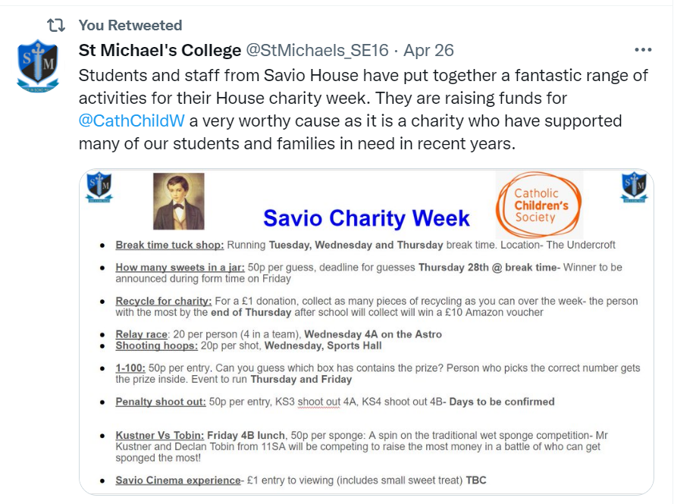
Fundraising for CCS
Connect different fundraising ideas to maximise your impact
For example, St Michael’s College students hosted a series of activities for a week
Notes:
Or you could even create multiple fundraising events, for example, St Michael’s College students hosted a series of activities for a week to raise money for CCS, with events such as a relay race and a cinema experience.

Slide 19
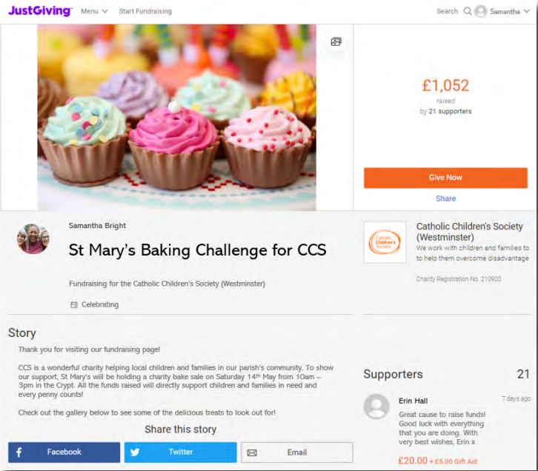
Fundraising for CCS
JustGiving online fundraising page is quick and easy way to start fundraising
This way you can keep your community updated with your fundraising journey
Notes:
You will be given fundraising boxes to collect donations, however another effective way of receiving donations is through a fundraising page, such as with JustGiving. You can create posts about your fundraising and keep your supporters updated with how your fundraising is going, and any upcoming fundraising events you may have.

Slide 20
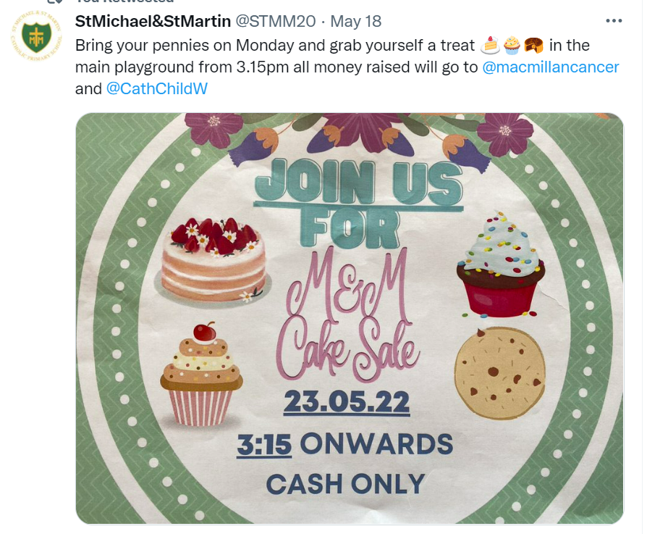
Fundraising for CCS
By raising awareness, you can gather more support
Share your fundraiser through posters, school newsletters, information for parents and online!
Notes:
Raising awareness of your fundraising and your fundraising events can really help you to gain more support in your fundraising efforts. Let people know you are fundraising, such as through posters in school, in your school newsletter or online, such as through JustGiving.

Slide 21
Fundraising for CCS
Top Tips
Create an online donation page ​
Ask parents, staff and governors to help ​
Make a week-long fundraiser and organise different activities ​
Share your fundraiser through the school newsletter and social media ​
Thank your sponsors to encourage donations

Slide 22
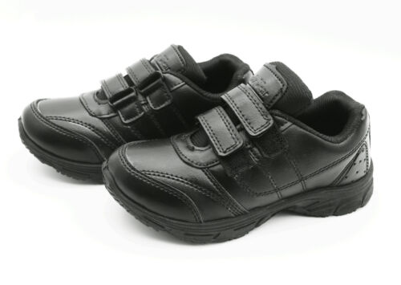
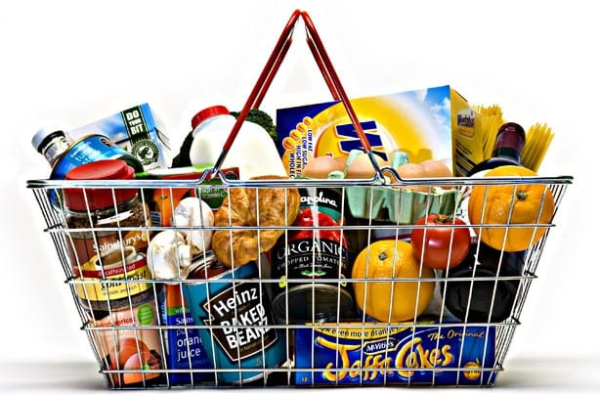
How does your support make a difference?
£15 can buy a child a pair of shoes
£25 can buy a coat to keep a child warm
£50 can buy food to feed a family for a week
£100 can buy a bed to help a child sleep at night
Notes:
As I said before, every penny you raise will go into the Crisis Fund and directly help children and young people in need. Just to give you an idea of the things we can buy with the money you raise

Slide 23
Thank you for listening! With your school’s support this Lent, we will help more children and families in need.
Notes:
I just want to say a really big thank you again to all of you here in school, for raising money for the Catholic Children’s Society’s Lent Appeal to help local children and young people in need.

