Slide 1
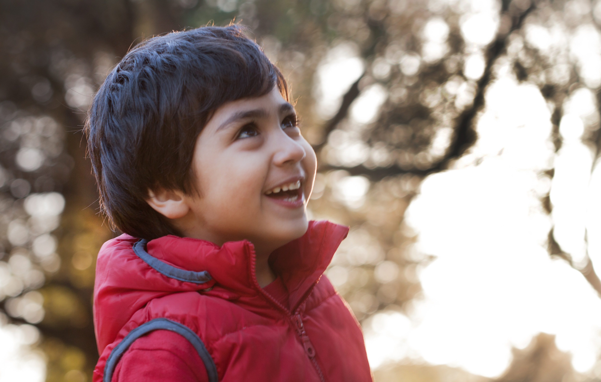
Hannah’s Story
Robbie’s Story
Sam’s Story
Billy’s Story
Annie’s Story
Sarah’s Story

Slide 2
Hannah’s Story

Slide 3
Hannah’s Story
Hannah and her mum recently had to move out of their home as it had become covered in black mould.
This was making it hard for Hannah to breathe, so they moved into a hotel.

Slide 4
Hannah’s Story
Hannah’s mum found a new home for them both.
But Hannah’s mum could not afford to replace all of the furniture and clothes they had to leave behind because of the mould.
They moved into their new house but it was completely empty.

Slide 5
Hannah’s Story
When Hannah’s mum dropped her off at school the next day and burst into tears. She told Hannah’s teacher what had happened and that she didn’t know what to do.
Hannah’s teacher immediately contacted the Catholic Children’s Society to see if they could help. Within 24 hours, CCS gave Hannah and her mum money to buy two beds, bedding, a sofa, replacement clothes and shoes.
Now Hannah has a clean and cosy home.

Slide 6
Reflection
Take a minute to reflect on Hannah’s story.
What problems did Hannah and her family face?
How did the Catholic Children’s Society help Hannah’s family?
How do you feel after hearing Hannah’s story?

Slide 7
Prayer
Dear Lord,
Guide us this Lent as we work together to build bridges and help everyone in our community.
Let us think about those children and families in need. Give us strength as we work to help them and bring comfort and hope to their lives.
Amen
Dear Lord,
Guide us this Lent as we use our voice to make a difference.
Let us think about those children and families in need. Give us strength as we work to help them and bring comfort and hope to their lives.
Amen

Slide 8
Robbie’s Story

Slide 9
Robbie’s Story
Robbie is nine years old and lives with his dad and little sister.
Recently, Robbie’s family were forced to move out of their council flat to somewhere further away from their school.
Robbie’s dad used to walk Robbie and his sister to school, but when they were moved they had to start taking the bus.

Slide 10
Robbie’s Story
Robbie’s dad struggled to afford the bus fare. Robbie and his sister began to arrive very late to school, and Robbie’s teacher noticed that he was tired and distracted in lessons.
One afternoon, Robbie’s teacher asked Robbie’s dad if anything was wrong. Robbie’s dad told Robbie’s teacher that he could not afford the bus, so the family were walking for an hour and a half to school every day.

Slide 11
Robbie’s Story
Robbie’s teacher got in touch with CCS that day and they quickly sent over money for the bus fare.
Robbie’s family are still waiting for a flat closer to school, but in the meantime, they are able to get the bus every day. When they arrive at school, Robbie and his sister are happier and have much more energy.

Slide 12
Reflection
Take a minute to reflect on Robbie’s story.
What problems did Robbie and his family face?
How did the Catholic Children’s Society help Robbie’s family?
How do you feel after hearing Robbie’s story?

Slide 13
Prayer
Dear Lord,
Guide us this Lent as we work together to build bridges and help everyone in our community.
Let us think about those children and families in need. Give us strength as we work to help them and bring comfort and hope to their lives.
Amen
Dear Lord,
Guide us this Lent as we use our voice to make a difference.
Let us think about those children and families in need. Give us strength as we work to help them and bring comfort and hope to their lives.
Amen

Slide 14
Sam’s Story

Slide 15
Sam’s Story
Sam is seven years old and lives in a flat with his grandmother.
Sam’s grandmother is retired and doesn’t have very much money.
Recently the family’s fridge freezer and cooker broke.
Sam’s grandmother couldn’t keep any fresh food in the house or cook proper meals. They just ate plain bread and cups of watery soup.

Slide 16
Sam’s Story
Sam started to feel very hungry at school and struggled to concentrate.
Sam’s teacher saw the change in his mood and spoke to his grandmother. Sam’s grandmother explained that she was unable to store fresh food or cook meals.
Sam’s teacher contacted CCS and they sent Sam’s grandmother money to buy a fridge freezer and cooker.

Slide 17
Sam’s Story
Sam’s grandmother said:
‘I can’t explain how much this means to me. I’ve struggled with money for so long, and knowing I don’t have to pay the money back for the fridge and cooker is such a weight off my mind. Sam is so much happier and healthier.’

Slide 18
Reflection
Take a minute to reflect on Sam’s story.
What problems did Sam and his family face?
How did the Catholic Children’s Society help Sam’s family?
How do you feel after hearing Sam’s story?

Slide 19
Prayer
Dear Lord,
Guide us this Lent as we work together to build bridges and help everyone in our community.
Let us think about those children and families in need. Give us strength as we work to help them and bring comfort and hope to their lives.
Amen
Dear Lord,
Guide us this Lent as we use our voice to make a difference.
Let us think about those children and families in need. Give us strength as we work to help them and bring comfort and hope to their lives.
Amen

Slide 20
Billy’s Story

Slide 21
Billy’s Story
Billy is four-years-old and lives with his mum.
Billy recently became very ill at nursery and was rushed to hospital. Billy was in hospital having tests for over a month and his mum stayed with him.
Billy is now out of hospital and is feeling much better.

Slide 22
Billy’s Story
However, Billy’s mum did not get paid while she was in hospital with her son, so she didn’t have enough money for her rent payment. She was scared that the family would lose their home and that they would be made homeless.
Billy’s school contacted CCS to see if they could help.

Slide 23
Billy’s Story
Within 24 hours CCS provided Billy’s mum with the money to cover her rent payment.
Billy’s mum was so relieved and happy to keep their home.

Slide 24
Reflection
Take a minute to reflect on Billy’s story.
What problems did Billy and his family face?
How did the Catholic Children’s Society help Billy’s family?
How do you feel after hearing Billy’s story?

Slide 25
Prayer
Dear Lord,
Guide us this Lent as we work together to build bridges and help everyone in our community.
Let us think about those children and families in need. Give us strength as we work to help them and bring comfort and hope to their lives.
Amen
Dear Lord,
Guide us this Lent as we use our voice to make a difference.
Let us think about those children and families in need. Give us strength as we work to help them and bring comfort and hope to their lives.
Amen

Slide 26
Annie’s Story

Slide 27
Annie’s Story
Annie is seven-years-old and lives with her mum.
Annie’s mum recently became unwell and she struggled to pay her bills and food costs.
Then her washing machine broke and she had no money to fix it. Annie’s mum handwashed their clothes in the sink, but the clothes never dried properly – they smelt musty and soon started to rot.

Slide 28
Annie’s Story
Annie’s teacher noticed that her school uniform had started to smell so the teacher spoke to Annie’s mum.
Annie’s mum was very upset and explained that their washing machine had broken, and she had no money to replace it.

Slide 29
Annie’s Story
Annie’s school contacted CCS to ask for help.
CCS gave Annie’s mum the money she needed to buy a washing machine. They also gave the family food vouchers to help cover the cost of food whilst Annie’s mum recovered.
Annie’s mum is now feeling much better and the family are excited about the future.

Slide 30
Reflection
Take a minute to reflect on Annie’s story.
What problems did Annie and her family face?
How did the Catholic Children’s Society help Annie’s family?
How do you feel after hearing Annie’s story?

Slide 31
Prayer
Dear Lord,
Guide us this Lent as we work together to build bridges and help everyone in our community.
Let us think about those children and families in need. Give us strength as we work to help them and bring comfort and hope to their lives.
Amen
Dear Lord,
Guide us this Lent as we use our voice to make a difference.
Let us think about those children and families in need. Give us strength as we work to help them and bring comfort and hope to their lives.
Amen

Slide 32
Sarah’s Story

Slide 33
Sarah’s Story
Sarah is five and lives with her mum and younger brother.
Sarah’s mum recently lost her job and struggled to find a new one quickly.
She fell behind on rent payments and one night the landlord told the family to leave.
Sarah and her mum and brother spent the night on buses, trying their best to keep warm.

Slide 34
Sarah’s Story
The next day Sarah’s mum went to the council for help and Sarah and her mum and brother were rehoused in a hostel.
Eventually Sarah’s family were moved to a new flat, but it was completely empty with no beds, tables or chairs.
Sarah’s mum went to Sarah’s school to see if they had any advice.

Slide 35
Sarah’s Story
Sarah’s Headteacher contacted CCS.
CCS were able to provide Sarah’s mum with money to buy beds, a sofa, table and chairs.
Sarah and her brother are now living in a home of their own where they feel safe and happy.

Slide 36
Reflection
Take a minute to reflect on Sarah’s story.
What problems did Sarah and her family face?
How did the Catholic Children’s Society help Sarah’s family?
How do you feel after hearing Sarah’s story?

Slide 37
Prayer
Dear Lord,
Guide us this Lent as we work together to build bridges and help everyone in our community.
Let us think about those children and families in need. Give us strength as we work to help them and bring comfort and hope to their lives.
Amen
Dear Lord,
Guide us this Lent as we use our voice to make a difference.
Let us think about those children and families in need. Give us strength as we work to help them and bring comfort and hope to their lives.
Amen

